Slide 1
World wide Tourist Destination
Portfolio Assignment
Tourism 12

Slide 2
Destination #1- Country-Canada
http://members.shaw.ca/kcic1/mapmenu.html

Slide 3
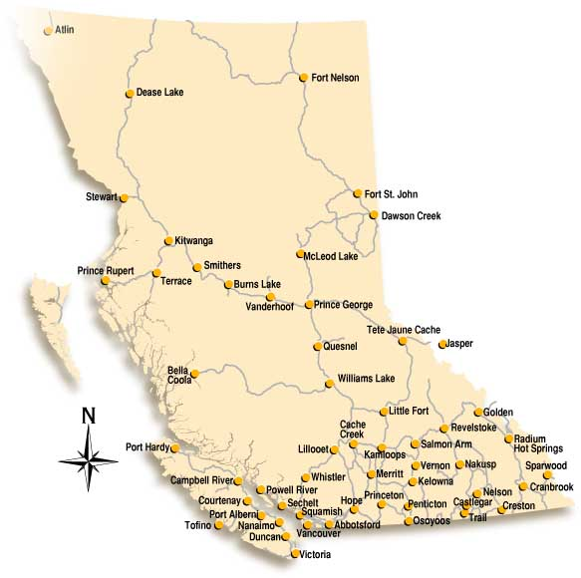
Destination-Prince Rupert, BC
http://www.th.gov.bc.ca/popular-topics/distances/bcmap.html

Slide 4
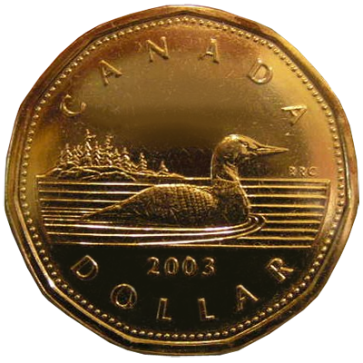
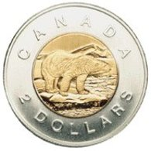
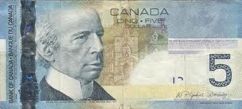
Unit of Currency
Prince Rupert, BC is in Canada so the Canadian dollar is the form of currency. $1 and $2 dollar denominations are in coin form, with higher amounts in dollar form.

Slide 5
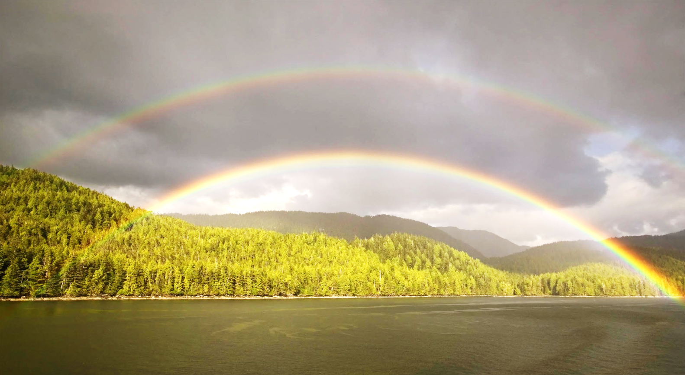
Climate of Prince Rupert, BC
http://fwallpapers.com/view/double-rainbow-over-prince-rupert-port-canada
Prince Rupert has a cool-to-mild climate. Average temperatures range between 4˚C and 17˚C. The city doesn't usually get snow in the winter but sometimes heavy storms rush through. The port city is actually the rainiest city in Canada, with an average of 250cm/100in rainfall annually, which contributes to the area's remarkable rainforests
Source: http://www.hellobc.com/prince-rupert/geography.aspx

Slide 6
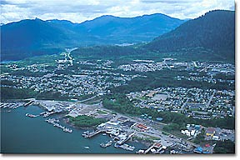
Physical Geography
http://www.britishcolumbia.com/regions/towns/?townID=3660
Prince Rupert is a coastal city, that is located on an island. It is surrounded by mountains and is in the middle of a temperate rain forest. It has many small lakes nearby and is close to the scenic mountain drive alongside the Skeena river on the way to Terrace. There are many types of wildlife such as deer, wolves, killer whales and bears.

Slide 7
Main languages spoken
The main language spoken is English. Some people also speak the language of the Tsimshian people –Smalga’ax.

Slide 8
Entrance requirements for travel
Entrance requirements can vary depending on where you are traveling from.
Most visitors need a passport and some may need additional papers.
http://www.cic.gc.ca/english/visit/index.asp
People can find out by following the links on the website.

Slide 9
Major tourism attractions (things to do)
http://www.visitprincerupert.com/
The best way to find out what to do is to visit the local tourism website.

Slide 10
Things to note/be aware of
No special things to remember.

