Slide 1
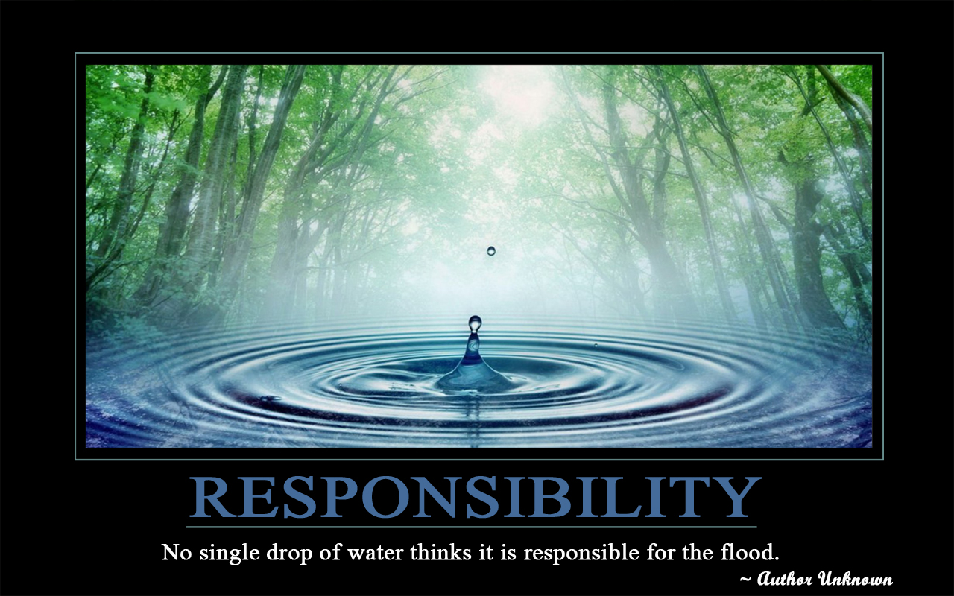
Getting started with serving it right
Course Introduction
The online Serving It Right (SIR) program is an interactive, self-study course that will educate you about your legal responsibilities when serving liquor.

Slide 2
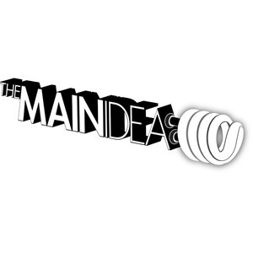
The course provides effective techniques to prevent problems related to the service of liquor and covers topics such as:
Signs of intoxication
Legal liability
Duty of care on and off premises, and
The necessity to create and enforce responsible beverage service policies

Slide 3
Responsible beverage service does not end with SIR certification. Skills can only be developed through practice and work experience. Therefore, further training is strongly encouraged to build upon the fundamental knowledge acquired through this course.

Slide 4
Preview How much do you know before reading this section? Test your knowledge before reading further. Don’t know any of the answers? Don’t worry. The learn section will cover all of these topics

Slide 5
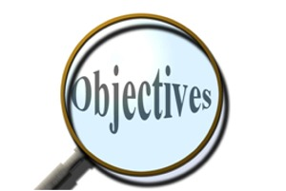
In this section you will learn:
What is Serving It Right™?
Who needs a Serving It Right certificate?
The modern view of alcohol
The impact of a responsible beverage service program

Slide 6
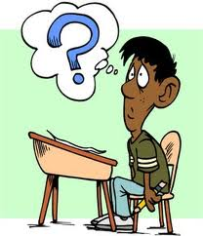
What is Serving It Right™?
The Purpose of Serving It Right
The goal of a responsible beverage service (RBS) program is to reduce alcohol-related problems. Serving It Right (SIR) is BC’s responsible beverage service program.

Slide 7
Who needs a Serving It Right certificate?
SIR is designed for:
people working in tourism and hospitality,
individuals whose special occasion license requires them to have Serving It Right,
What does it do?
encourages a responsible, caring and professional approach to the serving of alcohol.

Slide 8
SIR provides critical information on the effects of alcohol on people, and techniques for preventing over-service. This information will help you develop a more positive environment for your patrons, a professional image for your establishment, and increased awareness of your legal responsibilities around alcohol service.

Slide 9
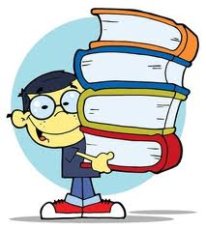
SIR educates licensees, servers and retailers to:
-understand the effects of alcohol on the body
-recognize signs of intoxication
-know their responsibilities under the law and the consequences
-know how to ID minors to prevent underage drinking
-know how to develop and/or support appropriate alcohol service policies
-know how to handle typical situations requiring intervention

Slide 10
History
The Serving It Right program was initiated during a provincial liquor policy review in 1987.
requested a mandatory responsible beverage service program for BC.
. Serving It Right is a joint initiative of both the Liquor Control and Licensing Branch and the hospitality industry

Slide 11
The involvement of these two groups ensured that:
the course gives information on provincial legislation and Liquor Control and Licensing Branch policies;
the skills and strategies presented in the course drew on expertise in the industry and work well in licensed establishments.

Slide 12
In 1989, -became mandatory for liquor primary establishments and their servers.
Since 1989, the provincial government has entrusted the responsibility for delivering Serving It Right to a non-profit tourism association—the Hospitality Industry Education Advisory Committee.

Slide 13
In 2003, after an 18-month task-force review, HIEAC changed its name to go2—The resource for people in Tourism.

Slide 14
The new SIR program
In 2005 and 2006, the provincial government, go2 and representatives of the hospitality industry evaluated and substantially updated the existing program..
The current version of Serving It Right was introduced in 2007, and now consists of a single program for retailers, licensees, servers and those required to obtain it for their special occasion licenses.

Slide 15
Who must have a SIR certificate?
Whether or not you—or your staff—require a Serving It Right certificate generally depends on the type of liquor license you have. There are four types of licenses issued to establishments or individuals serving food and beverages:

Slide 16
Food-primary licence (restaurants)
This type of license is issued to restaurants or food outlets where the service of food, not liquor, is the primary focus. Licensees, managers and all those who may be left in charge need to have a SIR certificate. If you have a restaurant lounge endorsement, the SIR program must be completed by all servers, not just those working in the lounge.

Slide 17
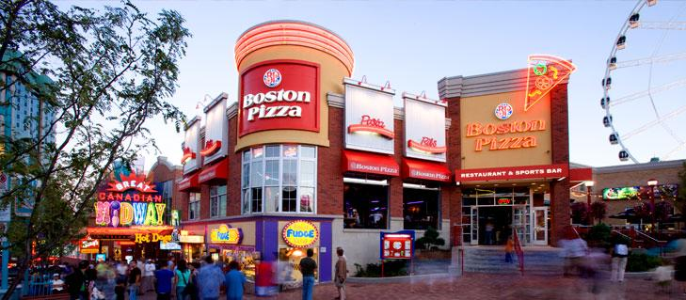
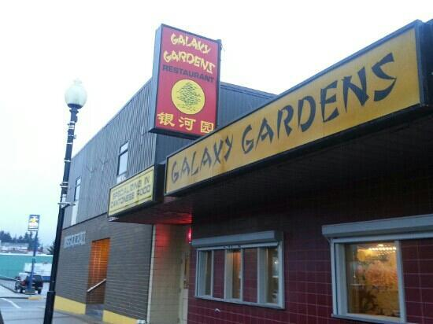
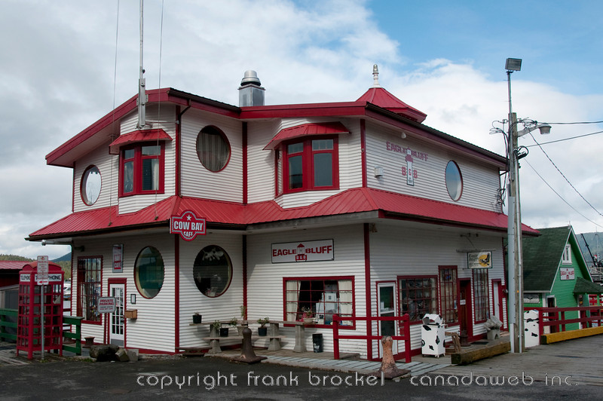
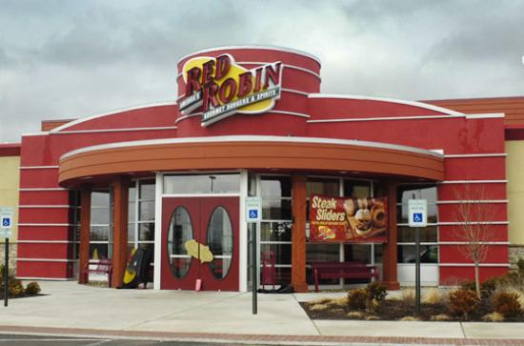
What are some examples?

Slide 18
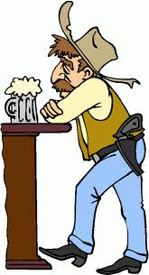
Liquor-primary license (bars, pubs, nightclubs, casinos, stadiums)
This license is issued to establishments whose primary business is hospitality, entertainment or beverage service, including bars, pubs, nightclubs, casinos and stadiums. Licensees, managers, servers and bartenders in these establishments must all have SIR certificates.

Slide 19
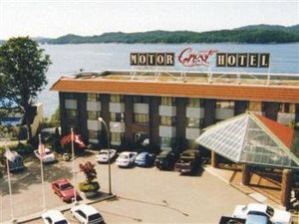
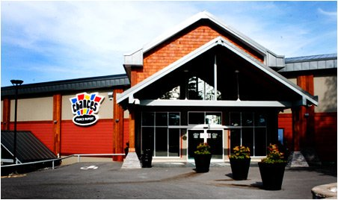
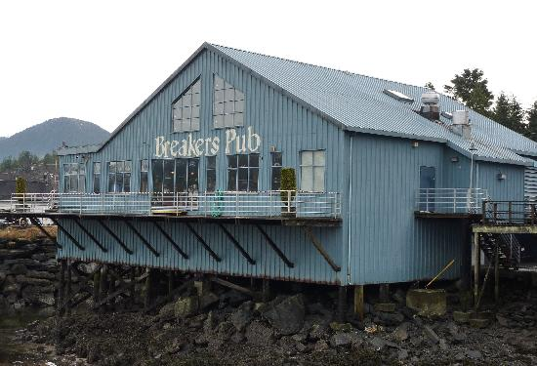
What are some examples?

Slide 20
Licensee retail store licence (private liquor stores)
Licensee retail stores, commonly known as private liquor stores, may sell all types of liquor. All licensees, managers and sales staff at BC retail liquor stores must have SIR certificates.

Slide 21
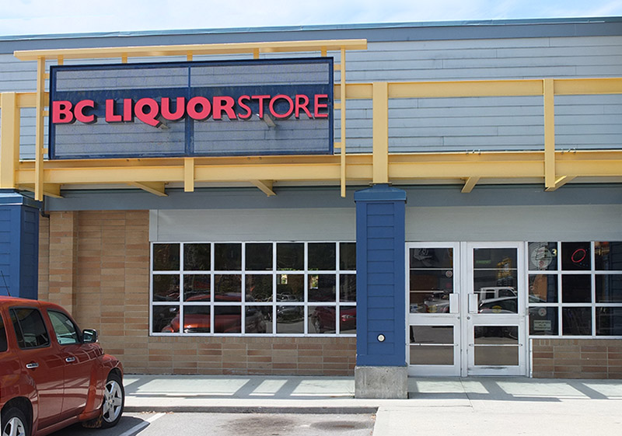
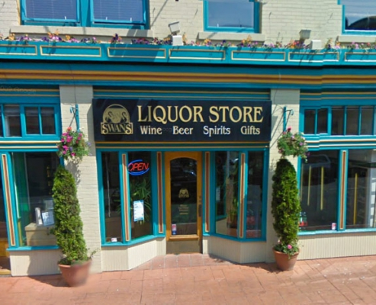
What are some examples?

Slide 22
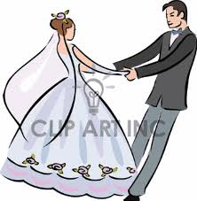
Special occasion license
A special occasion license (SOL) is required for not-for-profit special occasions such as weddings and community festivals where alcoholic drinks will be served or sold.

Slide 23
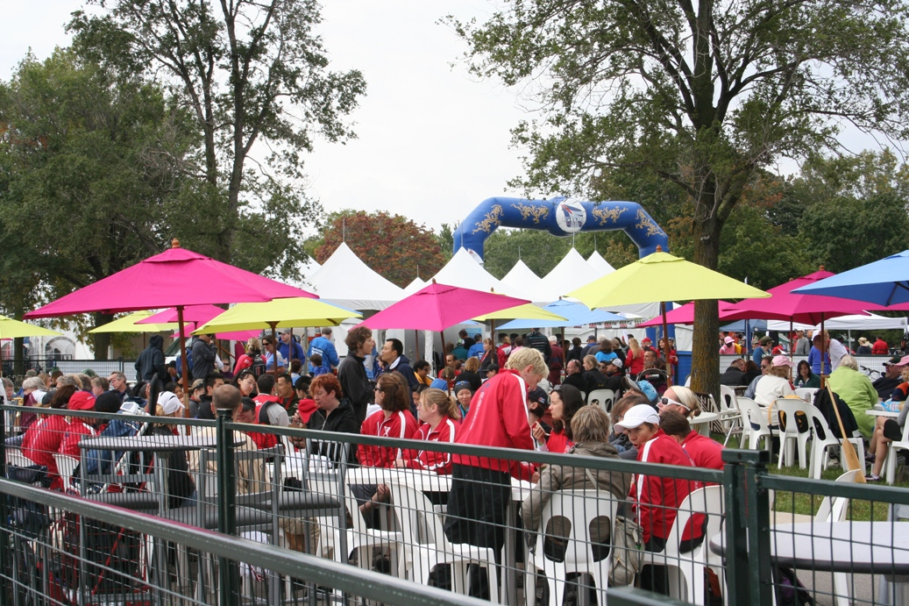
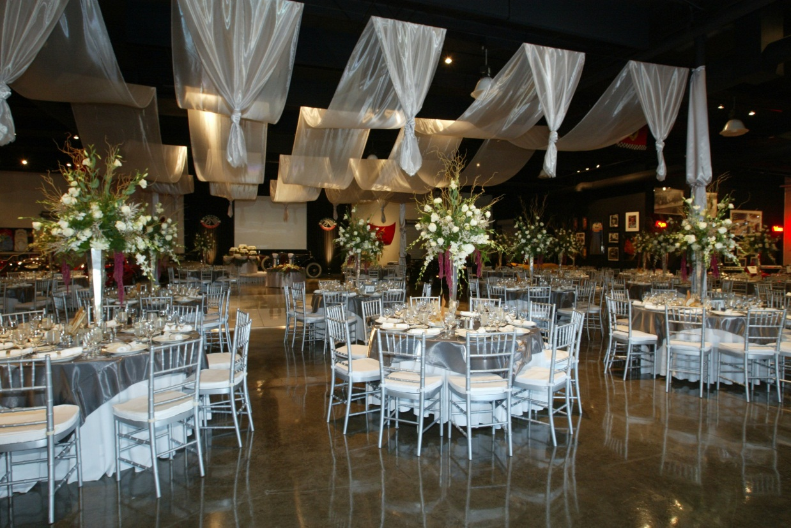
What are some examples?

Slide 24
The effects of too much alcohol
While the majority of alcohol consumers in the province drink responsibly most of the time, there are occasions where people drink and put their health and safety at risk.
40% of British Columbians admit to drinking in ways that could lead to falls, accidents or incidents of violence;
Almost 20% of British Columbians drink in a risky way at least once a month.

Slide 25
The effects of too much alcohol
“illicit drugs get all the headlines, but alcohol causes more harm in terms of premature deaths and in health, social and economic costs.”
Every year in BC,
the financial burden of alcohol-related harm exceeds $2 billion, and
35% of British Columbians report that they have suffered physical, emotional or financial harm as a result of someone else's alcohol use.

Slide 26
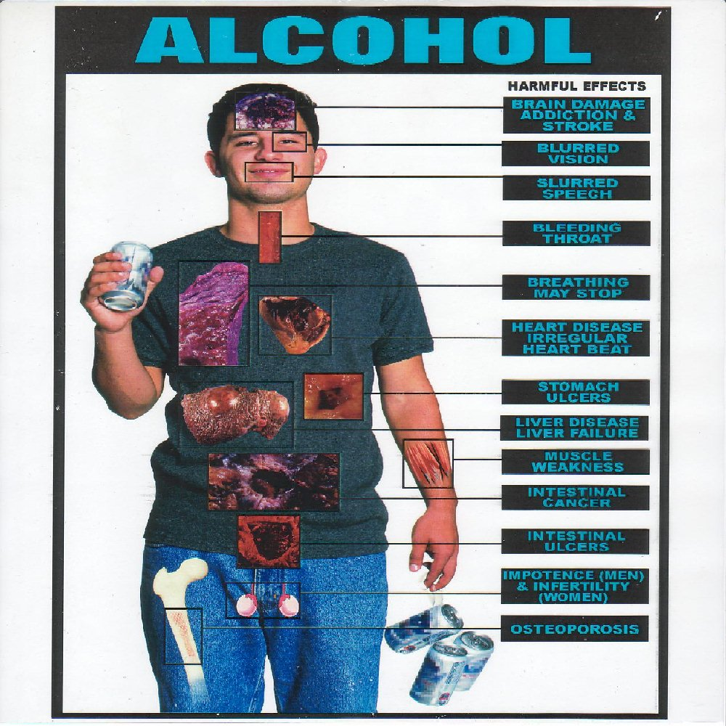

Slide 27
http://www.youtube.com/watch?v=kDfPDHaBU3U
http://www.youtube.com/watch?v=zXjANz9r5F0

Slide 28
http://news.bbc.co.uk/2/hi/health/1721987.stm
http://www.youtube.com/watch?v=mulJpjJh29k
http://www.youtube.com/watch?v=jN19Jx0hrwY
http://www.youtube.com/watch?v=zuVk-Ecc44A
http://www.youtube.com/watch?v=Ki9mZMtPQUc
http://www.youtube.com/watch?v=D_Yqc_FzNAI

Slide 29
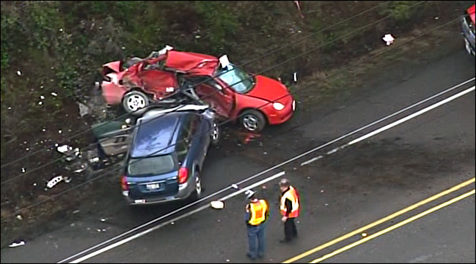
- 118 people in B.C. died as a result of impaired driving last year. (2008)
- 100 people in B.C. die as a result of failing to wear a seatbelt in an average year.
- 3,000 crashes in B.C. involve alcohol in an average year.
- 30 to 35 per cent of all traffic deaths are due to alcohol or drug impairment.
- One in 10 drivers on the road are impaired after 10 p.m. on a typical night.
- One in 20 drivers and passengers don't wear seatbelts.
- 65 per cent of impaired drivers aren't wearing a seatbelt.
- 401 people died in traffic accidents in B.C. in 2006.

Slide 30
The modern view of alcohol
1. Governments and the public are concerned about alcohol over-consumption- ie.health issues, impaired driving and overall public safety.
2. As a result, the Centre for Addictions Research of BC and the BC Ministry of Health are promoting low-risk drinking guidelines.

Slide 31
3. Programs such as Mothers Against Drunk Driving (MADD) and Drinking Driving Counter Attack show that society will not tolerate the consequences of drinking and driving.
4. Young people are more aware than ever before of alcohol-related issues, as is evident in dry grads and designated-driver programs.

Slide 32
5. Laws and regulations have also changed as a result of this changing environment. Injured parties from alcohol-related incidents are taking their cases to court, where, increasingly, judges assign a percentage of the fault to commercial hosts.
6. Courts are placing an expanding responsibility on the owners, managers and staff of licensed establishments to provide responsible beverage service.

Slide 33
Why should we have a responsible beverage program?

Slide 34
The impact of a responsible beverage service program
Implementing a responsible beverage service program in every alcohol-serving establishment in BC can decrease service-related alcohol problems.
An RBS program provides servers, managers and licensees with the knowledge necessary to meet their responsibilities, including eliminating the sale and service of liquor to minors and reducing over-consumption of alcohol in licensed establishments.

Slide 35
How can having a service like this prevent alcohol related problems?

Slide 36
Increased responsibility is being placed on owners, managers and staff to provide responsible beverage service.
This increases liability on those people in the courts when alcohol related incidents occur.

Slide 37
Why is liability an important factor for you as a server?

Slide 38
Review questions
Quick review test
1. What is a responsible beverage service program designed to do?
2. What is the difference between a food-primary license and a liquor-primary license?
3. On whom are courts placing increased responsibility to provide responsible beverage service?

Slide 39
Review
http://www.servingitright.com/getting_started_review.html

Slide 40
Resources
http://www.servingitright.com/getting_started_appendix.html
Liquor Control and Licensing Branch
www.pssg.gov.bc.ca/lclb/index.htm For further information about alcohol, substance abuse, low-risk drinking guidelines and a chart on drinking assessment, visit the Centre for Addictions Research of BC at:
www.carbc.ca/AODMonitoring/tabid/541/Default.aspx
More information regarding Fetal Alcohol Spectrum Disorder can be obtained at:
www.heretohelp.bc.ca/publications/factsheets/fasd

Slide 41
Alcohol Effects and Intoxication
Preview
How much do you know before reading this section? Test your knowledge before reading further. Don’t know any of the answers? Don’t worry. The learn section will cover all of these topics.

Slide 42
In this section you will learn:
How to recognize intoxication and the over-consumption of alcohol
The effects of alcohol in combination with drugs
What is blood alcohol concentration and a standard drink

Slide 43
What are some facts you know about alcohol-its effects, and the law?

Slide 44
Teasers
Almost 20% of British Columbians drink in risky ways at least once a month.
A person who is legally impaired with a blood alcohol concentration of .08% takes more than five hours to become completely sober.
Enforcement officers can enforce administrative and monetary penalties against a driver with a blood alcohol concentration of 0.05% or above.

Slide 45
http://www.drinkingfacts.ca/english/quizzes.asp
http://drinkingfacts.ca/english/downloads/facts.pdf

Slide 46
Pretest
Select the best answer for each question.
http://www.servingitright.com/alcohol_effects_preview_2.html

Slide 47
What does it mean to be intoxicated?

Slide 48
Intoxication part one
1. What is intoxication?
As a result of consuming alcohol, an intoxicated person does not have the normal use of physical or mental faculties. There is no single scientific measure that determines whether a person is intoxicated, since intoxication is an observed state. Therefore, determining whether a person is intoxicated requires observing a person’s mental and physical state, and comparing that state and observed behaviour to a normal person in full possession of his or her faculties.

Slide 49
How does someone become intoxicated?

Slide 50
How intoxication happens
2. How intoxication happens
As the alcohol reaches the stomach, some of it is absorbed and promptly enters the bloodstream. However, most of it passes on into the small intestine, where it is absorbed and also enters the bloodstream. Approximately 90% of the alcohol leaves the body after being processed by the liver. This organ is able to process alcohol at a relatively fixed rate of one standard drink per hour. A person's intoxication is increased when alcohol is being absorbed at a faster rate than it is being processed.

Slide 51
http://science.howstuffworks.com/alcohol.htm
http://www.dummies.com/how-to/content/how-your-body-processes-alcohol.html

Slide 52
What are the effects of intoxication on the body and its ability to function?

Slide 53
3. Effects of intoxication
As alcohol builds up in the body, the activity of the brain, heart and lungs may slow down. Alcohol can be absorbed, enter the bloodstream and travel to the brain in as little as three minutes. Early effects of alcohol consumption include impaired judgment, loss of self-control and lessening of inhibitions. As more alcohol reaches the brain, the person’s physical abilities become significantly impaired, and coordination is lost.

Slide 54
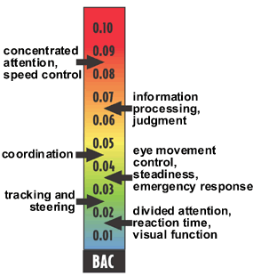

Slide 55
http://news.bbc.co.uk/2/hi/health/1721987.stm
http://www.youtube.com/watch?v=mulJpjJh29k
http://www.youtube.com/watch?v=jN19Jx0hrwY
http://www.youtube.com/watch?v=zuVk-Ecc44A
http://www.youtube.com/watch?v=Ki9mZMtPQUc
http://www.youtube.com/watch?v=D_Yqc_FzNAI

Slide 56
What does the law say about serving alcohol to people who are intoxicated?

Slide 57
By law, no one in BC is allowed to sell or serve alcohol to a person who is intoxicated or apparently intoxicated. The term “apparently intoxicated” places a great deal of responsibility on you to judge when a person is approaching intoxication or is already intoxicated.

Slide 58
Common myths about alcohol There are many myths regarding alcohol and alcohol consumption. Knowing the truth may help you understand customer behaviour.

Slide 59
What do you think are the myths?

Slide 60
True or false
Alcohol makes you happy.

Slide 61
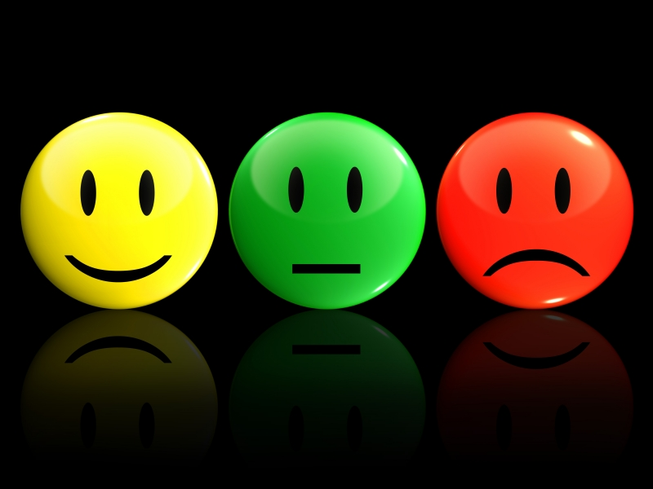
Myth 1: Alcohol makes you happy
How you will feel depends on your mood when you start drinking. If you are sad or angry before you drink, the alcohol may initially put you in a better mood. But then the opposite can occur, and you may well end up even sadder or angrier than you were before you started.

Slide 62
True or false
Mixing drinks causes higher levels of intoxication. (ie. Makes you more drunk)

Slide 63
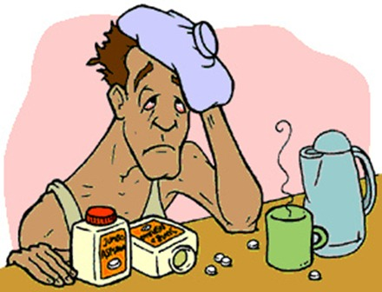
Myth 2: Mixing drinks causes higher levels of intoxication
Mixing drinks does not cause greater intoxication. It does increase your chances of a hangover, though, and may make you feel sick.

Slide 64
True or false
Alcohol warms you up.

Slide 65
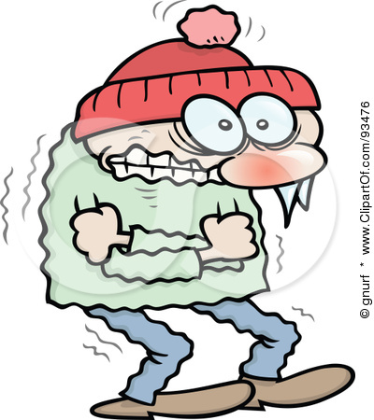
Myth 3: Alcohol warms the body
The opposite is true. Alcohol opens up the pores of the skin, allowing perspiration to increase, which lowers body temperature.

Slide 66
True or false
Alcohol relieves stress.

Slide 67
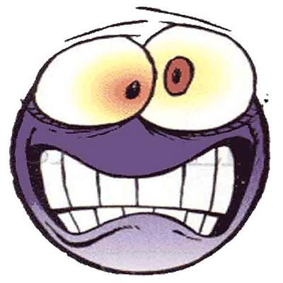
Myth 4: Alcohol relieves stress
Alcohol may seem to relieve stress in the short term; however, it does not treat the underlying cause of stress. Indeed, the use of alcohol can lead to increased anxiety, which in turn may lead to the use of alcohol as self-medication and potential alcohol dependency.

Slide 68
True or false
Alcohol improves coordination.

Slide 69
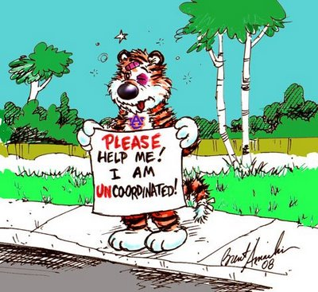
Myth 5: Alcohol improves coordination
Some people will try to tell you they are better at darts after a few drinks. In fact, the motor functions that control coordination are affected by alcohol immediately.
http://video.answers.com/learn-about-alcohols-effects-on-reaction-times-145242089

Slide 70
True or false
Alcohol helps you sleep.

Slide 71
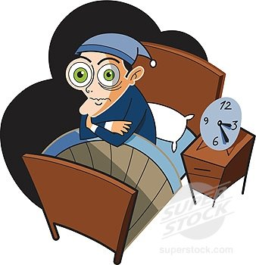
Myth 6: Alcohol helps you sleep
Alcohol can help you fall asleep, but once the alcohol levels are reduced by the passage of time, normal sleeping patterns are disrupted. This is why heavy drinkers feel tired in the morning. Alcohol can also cause insomnia and aggravate existing sleep problems.

Slide 72
True or false
Drinking coffee will sober you up.

Slide 73
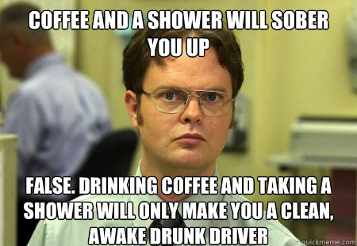
Myth 7: Drinking coffee will sober you up
There is only one way to sober up: time. Cold showers, drinking coffee and dancing will not sober an intoxicated person up faster.

Slide 74
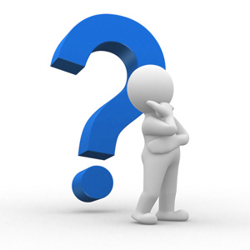
What factors influence intoxication?

Slide 75
Factors that influence intoxication
1. Rate of consumption
Increasing the number of drinks consumed in a given time period will greatly influence the rate of intoxication.

Slide 76
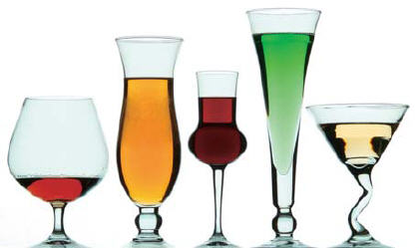
Factors that influence intoxication
2. Amount consumed
“Doubles” and drinks made with more than one type of liquor typically contain more alcohol than standard drinks (a five-ounce glass of wine, or a 12-ounce glass of beer).

Slide 77
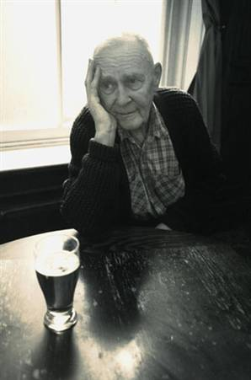
Factors that influence intoxication
3. Age
Young and healthy people break down alcohol faster than the elderly and people in poor health. Younger patrons have more blood in their system, and their livers process alcohol more efficiently.

Slide 78
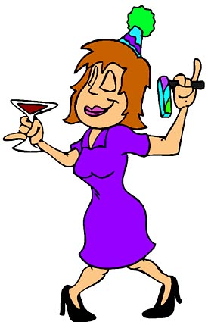
Factors that influence intoxication
4. Gender
Women generally have more body fat than men and less body water with which to dilute alcohol. Women also have lower levels of the metabolizing enzyme required to break down alcohol.

Slide 79
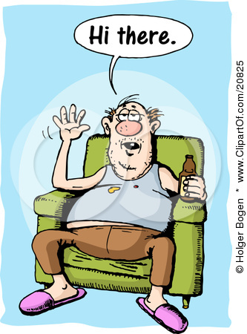
Factors that influence intoxication
5. Body weight and type
An overweight person generally becomes intoxicated faster than a muscular person who weighs the same and drinks the same amount of alcohol. Fatty tissue contains less water than muscle, so overweight bodies are less capable of diluting alcohol.

Slide 80
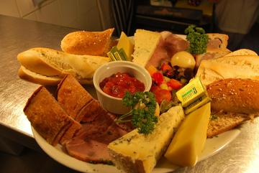
Factors that influence intoxication
6. Food consumption
Food slows the absorption of alcohol into the bloodstream. On an empty stomach, alcohol reaches the brain in a few minutes and begins to affect behaviour and coordination. After a full meal, alcohol can take up to six hours to reach the brain. Food does not absorb the alcohol. It merely slows the speed at which alcohol is absorbed. Fatty foods are especially effective in slowing down the alcohol-absorption process. As fatty foods are more difficult to digest, they remain in the stomach longer than other types of food. The effect of the alcohol still occurs, but at a slower rate.

Slide 81
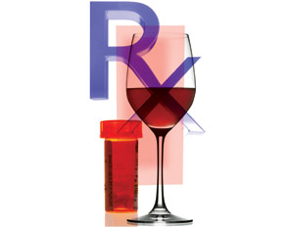
Factors that influence intoxication
7. Medication and other drugs
Many common drugs (prescription medications, over-the-counter medications and illegal drugs) impair the user and increase the effects of alcohol. Using alcohol with other drugs can be very dangerous to a person’s health and safety.

Slide 82
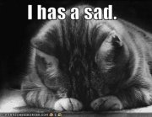
Factors that influence intoxication
8. Environment and mood
The surroundings, including interaction with other guests, may trigger emotional responses. Alcohol usually exaggerates moods. A person who is depressed or upset will likely become more depressed and upset when drinking

Slide 83
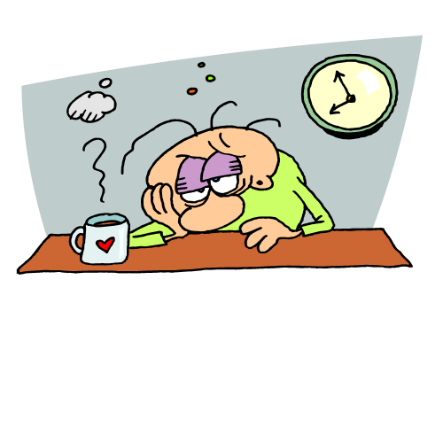
Factors that influence intoxication
9. Fatigue and stress
Physical, mental or emotional fatigue and stress make a person more susceptible to the effects of alcohol.

Slide 84
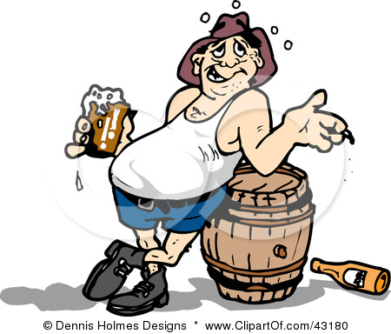
Factors that influence intoxication
10. Tolerance to alcohol
Experienced drinkers develop tolerance to alcohol. After prolonged regular drinking, the liver develops an ability to break down alcohol more rapidly, and brain cells may become less sensitive to alcohol. A person with a high tolerance takes more alcohol to show signs of visible intoxication, often resulting in an underestimation of alcohol’s invisible impact.

Slide 85
How can you tell someone has had too much to drink?
What are the signs?

Slide 86
Intoxication Part Two
Has your customer had too much to drink?
While determining whether a patron is intoxicated can be difficult, it is important to make an initial assessment of the guests as they enter your establishment or when they are first seated. A change in behaviour or abnormal behaviour is a good indication of the effects of alcohol consumption.

Slide 87
If you begin to notice signs of intoxication, you can adjust your service before the guest becomes intoxicated. The signs, which can appear in any order, include the following:

Slide 88
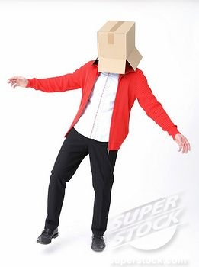
Stumbling or staggering
has difficulty standing upright
has difficulty walking a straight line
bumps into furniture and other patrons

Slide 89
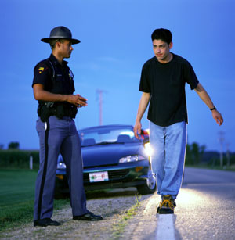
Poor hand-eye coordination
fumbles for items like cigarettes, change, ID
reaches for drink and misses or spills it

Slide 90
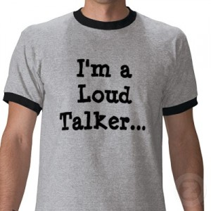
Changes or difficulties in speech
speaks too loudly for the situation
changes volume of speech (up or down) when there is no reason to suggest that a change is necessary; for example, speaks softly when there is no need to be secretive
speaking unusually slowly or rapidly
has difficulty speaking distinctly; words are blurred or run together
cannot get a word out or uses the wrong word

Slide 91
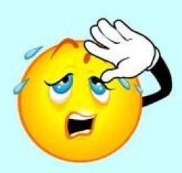
Nausea and sweating
looks nauseous or needs to throw up
sweats excessively, inconsistent with the surrounding temperature or conditions
sweats too much to be justified by nervousness, physical exertion or other logical factors

Slide 92
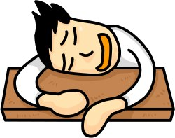
Sleepiness and breathing changes
has tired, heavy or closed eyes
has a placid, fixed gaze
nods off, then jerks head upright
breathes noticeably slower
breathes shallowly or weakly

Slide 93
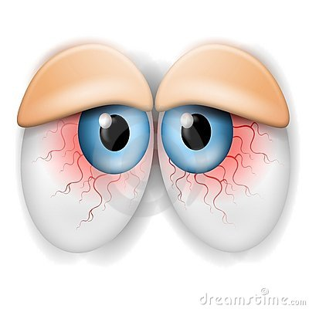
Blurred vision
has trouble reading menus or signs
cannot fix eyes on an object
has bloodshot eyes (to any degree)

Slide 94
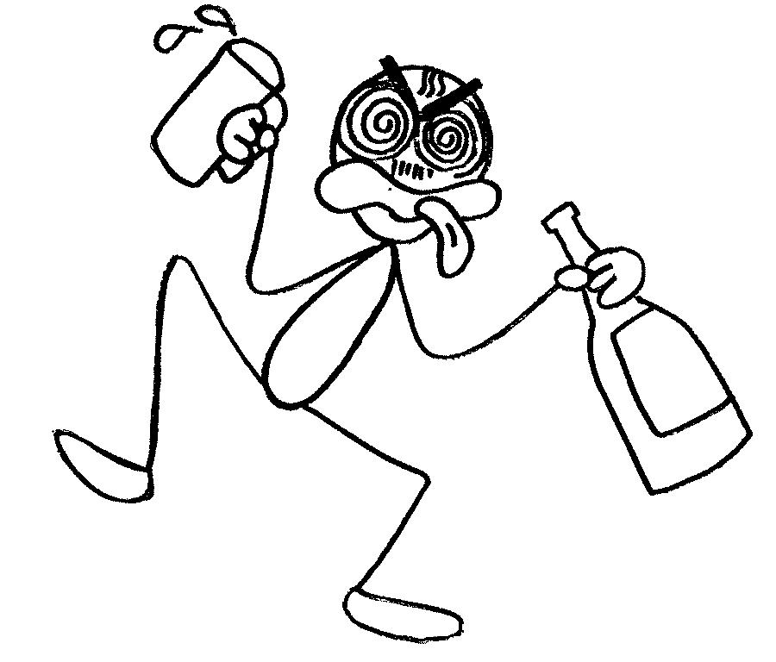
Overconfident or acts inappropriately
boasts unrealistically about what he or she can do; inflated sense of confidence
makes inappropriate comments to server or other customers
acts out inappropriate behaviour; reasoning is impaired
makes unusual personal requests
exaggerates personal importance

Slide 95
Confused or less alert
places an order and then forgets what was ordered
has difficulty understanding what is said
requires too long to respond to questions or to react to events; for example, when asked to place an order
has difficulty paying attention to the conversation
gets easily distracted or is off-topic

Slide 96
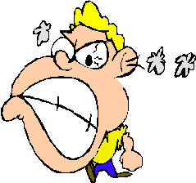
Aggressiveness
aggressive speech
threatens physical assault
is argumentative and uncompromising

Slide 97
http://news.bbc.co.uk/2/hi/health/1721987.stm
http://www.youtube.com/watch?v=mulJpjJh29k
http://www.youtube.com/watch?v=jN19Jx0hrwY
http://www.youtube.com/watch?v=zuVk-Ecc44A
http://www.youtube.com/watch?v=Ki9mZMtPQUc
http://www.youtube.com/watch?v=D_Yqc_FzNAI

Slide 98
This is not an exhaustive list. Discuss signs of intoxication with other staff at your establishment. Point out signs of intoxication to each other, or check with more experienced staff if you think you see some signs but are unsure.
One problem is that by the time changes in behaviour are obvious, the patron may already be intoxicated. Your objective is to be able to spot the subtle changes in your customers as they drink, so you can identify when they have had enough before they are intoxicated.

Slide 99
How do other drugs affect alcohol and its affects?

Slide 100
Alcohol with other drugs
The effects of alcohol in combination with other drugs
The presence of alcohol in conjunction with other drugs often intensifies effects. This is particularly the case when alcohol is joined with other depressants, due to their common capacity to slow down a person’s central nervous system. The impact can go beyond just making the person less coordinated or drowsier. Heart and breathing rate can sometimes become reduced to such an extent that the individual falls into a coma and these crucial functions stop.

Slide 101
Examples of Possible Indicators of Combined Alcohol and Other Drug Use
SYMPTOMS Intensified sedation, excessive dizziness (especially older people) | POSSIBLE INTERACTION INVOLVED Alcohol and antihistamines

Slide 102
Examples of Possible Indicators of Combined Alcohol and Other Drug Use
SYMPTOMS Intensified sedation Significantly slowed breathing Cold bluish skin Loss of consciousness | POSSIBLE INTERACTION INVOLVED Alcohol and narcotic pain relievers or heroin

Slide 103
Examples of Possible Indicators of Combined Alcohol and Other Drug Use
SYMPTOMS Severe drowsiness Depressed or even arrested cardiac & respiratory functions | POSSIBLE INTERACTION INVOLVED Alcohol and sedatives or hypnotics (benzodiazepines, tranquillizers, sleeping pills, barbiturates)

Slide 104
Examples of Possible Indicators of Combined Alcohol and Other Drug Use
SYMPTOMS Intensified impairment in concentration, perception, reaction and control | POSSIBLE INTERACTION INVOLVED Alcohol and cannabis (marijuana)

Slide 105
Examples of Possible Indicators of Combined Alcohol and Other Drug Use
SYMPTOMS Intensified euphoria Sudden heart, respiratory failure | POSSIBLE INTERACTION INVOLVED Alcohol and cocaine

Slide 106
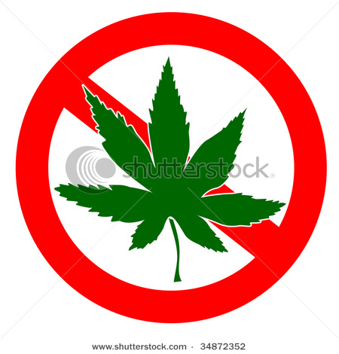
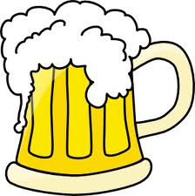
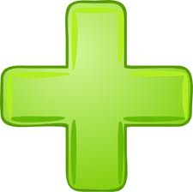
Some illegal drugs, such as marijuana, and prescription medicines, such as cough syrups, can increase intoxication levels by a factor of five, making people appear more intoxicated than they should for the amount of alcohol consumed.
5x as intoxicated

Slide 107
Driving after combining alcohol with other drugs can substantially increase the risk of a motor vehicle accident. In addition, the risk of accidental injury—such as falls among the elderly, or overdose—is greatly increased when some types of drugs are used in combination with alcohol.

Slide 108
Alcohol interactions with other drugs can bring about quite unpredictable effects. Servers need to apply careful vigilance, observing patrons not just for intoxication but also for a real exaggeration of initial and more protracted symptoms normally associated with alcohol intake:

Slide 109
euphoria instead of just relaxation and giddiness,
worse dizziness,
slow reflexes,
slurred speech,
blurred vision,
disorientation or
extreme drowsiness.

Slide 110
Have emergency numbers (including the BC Poison Control Centre) in a place where all staff has quick access in case you need to call for help.

Slide 111
What could you do to try and determine if symptoms are medical or alcohol related?

Slide 112
Mistaking illness or disability for intoxication
Occasionally, signs of intoxication are due to an illness or disability rather than alcohol consumption. Symptoms may be similar to that of alcohol intoxication. An initial assessment is important to determine whether the guest is ill or intoxicated. Asking guests whether they feel ill and noting medical alert jewelry, such as a diabetic bracelet, are important steps in determining whether someone is sick. Discontinuing service and helping the guest to receive medical attention can be life-saving in some instances.

Slide 113
What does the law say about blood alcohol content when it comes to driving?

Slide 114
Drinking and Driving
Impairment and blood alcohol concentration
In the first part of this section you learned about intoxication, which is identified by observing a person’s mental and physical state.

Slide 115
Like intoxication, impairment can be an observed state; however, it can also be measured. The law recognizes that impairment begins when a person has a blood alcohol concentration (BAC) at or exceeding 50 milligrams of alcohol per 100 millilitres of blood, or .05%. The criminal code fail level for impairment is when a person's BAC is at or above .08%. This appears to be a small amount — about one drop of alcohol in 1,200 drops of blood. However, the effects of even a fraction of 1% alcohol content in the bloodstream are potent.

Slide 116
Consider that:
a BAC of .30% can cause a person to lose consciousness.
with a BAC of .40%, a person will be in a coma or could die.

Slide 117
http://www.videojug.com/interview/driving-while-intoxicated
http://www.5min.com/Video/The-Effects-of-Drugs-and-Alcohol-on-Driving-145242696
http://www.youtube.com/watch?v=FP2Z73RwDLI
http://www.youtube.com/watch?v=0NBFAD2e_j4
http://www.youtube.com/watch?v=Ki9mZMtPQUc
http://www.5min.com/Video/Drunk-Driving-Simulation-490698251

Slide 118
Impaired driving
A person can be legally unfit to drive if:
his or her BAC is at or above .05% or
his or her ability to drive is impaired by the use of alcohol, drugs or other factors.

Slide 119
What methods can a police officer use to determine if you are impaired?
http://www.videojug.com/interview/dui-signs-of-intoxication-2

Slide 120
Many law enforcement agencies use breath alcohol testing devices like the Breathalyzer to determine a person’s BAC. In the absence of admissible evidence of BAC, the prosecution in a drunk-driving case may rely on the observations of a police officer or a layperson as to the accused person's impairment. Such evidence may include erratic driving and physical and behavioural indicators like slurred speech, bloodshot eyes and difficulty walking a straight line.

Slide 121
Thus, a person can be guilty of impaired driving even though their BAC is below .05%. Similarily, a person is guilty of impaired driving with a BAC at or above .05%, whether or not their ability to operate the vehicle is visibly affected by alcohol consumption.

Slide 122
What are the penalties for impaired driving?

Slide 123
Penalties for Impaired Driving
Any person who is found to be driving with a BAC at or above .05% can face penalties including immediate suspension of their driver's license, vehicle impoundment and monetary fines. Click here for more detail on BC's drinking and driving legislation.

Slide 124
Driver road safety
http://www.pssg.gov.bc.ca/osmv/404redirect.html

Slide 125
Measuring BAC
The only way of accurately measuring BAC is to use a Breathalyzer or conduct a blood test. A practical technique for you to estimate a customer's BAC is to observe how many standard drinks (defined as a drink containing the equivalent of 0.6 ounces of 100% alcohol) are served and consumed by the customer while at your premises. A customer's BAC will depend on factors including his or her sex, weight, the number of drinks he or she has consumed and the number of hours since the first drink (see the Resources part of this Section).

Slide 126
What is the size of a standard drink?

Slide 127
The standard drink
A standard drink (SD) = 0.6 ounces of 100% alcohol.
This means, for example, that a five-ounce glass of 12% alcohol wine is considered a standard drink because it has the same effect on the human body as 0.6 ounces of 100% alcohol.

Slide 128
With low-alcohol beer and wine, a normal serving will be less than a standard drink, because the beverage has lower alcohol content. Therefore, a glass of light wine at 9% alcohol volume would be less than one SD. Similarly, light beers generally contain 4% alcohol, which is less than one SD.

Slide 129
There are also higher alcohol versions of beer and wine. Malt beer and ciders often contain 7% alcohol volume. Some full-bodied red and fortified wines can range from 14.5% to 21% alcohol levels. These higher alcohol versions should be served at a slower rate, as they are more potent.

Slide 130
Spirits in mixed drinks can be sold in 1, 1¼ or 1½-ounce shots. Again, the alcohol volume would affect the standard drink calculation.

Slide 131
Understanding the standard drink and its equivalencies is important because it allows you to monitor your patrons' intake, regardless of the beverage type. The liver can only process a fixed amount of alcohol, about one standard drink per hour. By determining the number of standard drinks consumed by a customer over time, and consulting with the chart on How to Calculate BAC (see the Resources part of this Section), you will be able to monitor the consumption of your customers to help ensure that they do not leave your premises and drive while impaired.

Slide 132
Calculating the standard drink
The following is a basic SD comparison. All of these drinks have the same effect on the body and are equivalent to one SD.

Slide 133
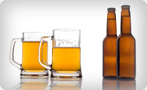
12 ounces beer with 5% alcohol volume = 0.6 ounces alcohol

Slide 134
1 ½ ounces spirits with 40% alcohol volume = 0.6 ounces alcohol

Slide 135
5 ounces wine with 12% alcohol volume = 0.6 ounces alcohol

Slide 136
How to use this knowledge on the job
The key to responsible alcohol service is to know when to discontinue service.

Slide 137
Assess guests as they enter your establishment. Are they already showing signs of intoxication? What factors (like their gender, weight, or age) might affect their impairment level? Try to determine ahead of time approximately how many drinks to serve to individual customers before discontinuing service.

Slide 138
By law, no one in BC is allowed to sell or serve alcohol to a person who is intoxicated or apparently intoxicated. The term “apparently intoxicated” places a great deal of responsibility on you to judge when a person is approaching intoxication or is already intoxicated.

Slide 139
Review
http://www.servingitright.com/alcohol_effects_review.html
Questions to ask at work
Are there myths about alcohol that are still treated as truths in our establishment?
Are we aware of the alcohol levels of all the drinks we serve?
Do we look for signs of intoxication in guests prior to serving alcohol?
Can we recognize behaviour that is drug related?

Slide 140
Resources
How to calculate Blood Alcohol Concentration
The following table outlines the typical blood alcohol concentration of people of varying weight, based on the number of standard drinks he or she has consumed.
This chart is provided for information only, as a means to estimate blood alcohol concentration (BAC). Many factors can affect a person's BAC, including amount of alcohol consumed, rate of consumption, food consumption, and factors specific to each person such as gender, age, weight, height and metabolism.
http://www.servingitright.com/alcohol_effects_appendix.html

Slide 141
Male

Slide 142
Female

Slide 143
How long after you have taken a drink can it still increase your Blood alcohol content?

Slide 144
Please note the following:
Actual BAC may differ from the numbers on this chart.
Impairment begins with one drink.
It may take up to 30 minutes after the last drink of alcohol for a person to reach the highest BAC level.
Mixing energy drinks, drugs or other medications with alcohol can increase a person's level of impairment.
If a person's BAC is .08 or over, the person is considered impaired under the Criminal Code of Canada.
If a person's BAC is .05 or over, the person is considered impaired under British Columbia's Motor Vehicle Act.
Different drinks contain different concentrations of alcohol.

Slide 145
Preview-Alcohol and the Law
How much do you know before reading this section? Test your knowledge before reading further. Don’t know any of the answers? Don’t worry. The learn section will cover all of these topics.

Slide 146
In this section you will learn:
Your obligations under the law related to the sale and service of alcohol
The consequences of failure to meet those obligations
How to minimize your legal risk

Slide 147
Teasers
According to ICBC, more than four million Canadians admit to having driven after drinking. Each year, about 12.5 million trips are made by people who thought they'd had too much to drink.
Approximately 35% of fatal vehicle crashes involve alcohol.
Courts in British Columbia have assigned up to 50% of the blame to establishments that allow intoxicated patrons to drink and drive and then cause injury or death to other citizens.
When intoxicated patrons injure themselves due to hazardous conditions or activities on the licensees’ premises, courts in BC have assigned up to 75% of the blame to the establishment.

Slide 148
Pretest
http://www.servingitright.com/alcohol_and_law_preview_2.html

Slide 149
The law and alcohol
There is a large body of law regulating the sale and service of alcohol in licensed establishments and the duties owed by licensees and their employees to patrons and members of the public. It is the duty of licensees and servers to be aware of their rights and responsibilities and to conduct their business activities accordingly.

Slide 150
The Liquor Control and Licensing Act
British Columbia’s Liquor Control and Licensing Act is the most important legislation governing the sale and service of alcohol in licensed establishments.

Slide 151
The Act, which is designed to maintain the orderly and responsible operation of licensed establishments, deals with
licensing requirements,
fees,
application processes,
operating terms and conditions such as hours of liquor service and entertainment policies,
inspections and law enforcement for licensed establishments.

Slide 152
Most importantly, it requires licensees and servers to control the activities that take place in their establishments, including the responsible sale and service of alcohol.

Slide 153
The Liquor Control and Licensing Act is supported by the Liquor Control and Licensing Regulation. The general manager of the Liquor Control and Licensing Branch administers the Act and the Regulation, both of which make it clear that those who serve alcohol in a licensed establishment have specific responsibilities.

Slide 154
Licensees must meet all applicable requirements of the Act and Regulation, as well as terms and conditions of their licence, which are periodically updated. It is the duty of all licensees to routinely familiarize themselves and their servers with the most recent modifications. Changes to the Act and Regulation, and terms and conditions of licences, are available on the Liquor Control and Licensing Branch website (see the Resources section).

Slide 155
The summaries below identify the key rights and responsibilities under the Act and Regulation, as they relate to alcohol service. They also outline some tips that will help you responsibly control alcohol service in your establishment.

Slide 156
Licensees and managers should refer to the Act and the relevant liquor licensee guides for their full range of legal obligations.

Slide 157
The Sale and Service of Liquor

Slide 158
What rules are there with regard to time when serving alcohol?

Slide 159
Time
You may sell liquor only during the hours noted on the licence.
tip
Let patrons know these time requirements by signal or announcement.
Do not sell large quantities to patrons at last call.

Slide 160
Time
You must ensure that all patrons leave your liquor-primary establishment (bars) within one half-hour of completing the liquor service, and you may not allow patrons to enter outside of the permitted hours for liquor service.
tip
Remind patrons of their limited time frame for consuming liquor and/or leaving the premises after the end of liquor service.

Slide 161
Time
You must remove liquor, drinks and glassware from tables in food-primary establishments (restaurants) within one half-hour of the end of liquor service.
tip
Offer to seal an unfinished bottle of wine for take-away by customers unable to complete it within the time frame allowed.

Slide 162
What rules are there with regard to dispensing liquor?

Slide 163
Dispensing liquor
You are permitted to pre-mix drinks by hand or by using such a device as a Bellini machine provided the liquor comes from the original containers purchased from the Liquor Distribution Branch.
tip
Learn correct measurements.

Slide 164
What rules are there regarding consumption of liquor?

Slide 165
Consumption of liquor
Licensees and employees must not consume liquor while working in the licensed establishment.
tip
Realize the importance of the employees’ appearance and behaviour, as all staff members represent the business.

Slide 166
Consumption of liquor
Ensure that only liquor purchased in your liquor-primary or food-primary establishment is consumed there. Liquor must not be consumed within a licensee retail store.
tip
Observe patrons and watch for signs of illegal drinks.
Do not sell unopened bottles for consumption on food primary and liquor primary premises.

Slide 167
Public safety

Slide 168
What rules are there with regard to public safety?

Slide 169
Capacity
You may not allow the number of patrons to exceed the capacity stated on your establishment's liquor licence.
tip
Know the capacity your establishment is licensed for.
Have door staff monitor the entry and exit of guests, preferably using mechanical counters.

Slide 170
What rules are there with regard to minors?

Slide 171
Minors (anyone under the age of 19)
You may not sell or give liquor to minors and you must check your liquor licence as to whether minors are allowed to be on premises where liquor is sold.

Slide 172
Minors (anyone under the age of 19)
Minors employed in food-primary establishments, or liquor-primary stadiums who are 16 or older may serve liquor but may not open bottles, pour or mix liquor. You must have adult staff supervising minors serving liquor.

Slide 173
Minors (anyone under the age of 19)
Two pieces of ID are required in BC for anyone who appears to be a minor.
tip
Learn to maintain door control and how to check a person's ID to ensure it is valid and legitimate. See Identification of Underage Drinkers for further information on checking ID.

Slide 174
How can you identify minors?

Slide 175
Identification of Underage Drinkers
Identification of people who should not be on your premises — for their protection and yours — is your first line of control. You are required to refuse service to those who are intoxicated. As well, you are required to refuse any service to minors. By setting a high standard right at the door of the establishment (or before you serve the first drink), you send a clear message to patrons. You will be respected and appreciated by the overwhelming majority of your guests.

Slide 176
When to ask for ID
It is illegal to sell, serve or supply alcohol to anyone under the age of 19 in BC. Don't be fooled by appearances. Many young people look much older than they really are. A licensed establishment is subject to stringent legal penalties if any alcohol is served to a minor. The minimum penalty is a 10-day licence suspension or $7,500 fine. Furthermore, a minor caught using false identification is subject to a $115 fine issued by police.

Slide 177
What are BC identification requirements?

Slide 178
Requirements for BC
Two pieces of ID are required in BC to verify age.

Slide 179
The first piece of identification must:
be issued by a government agency (Canadian or other) and
include the person's name, signature, birth date and picture.
* Examples of the first piece include a passport, driver’s licence or B.C. Identification (BCID) card.

Slide 180
The second piece must:
include an imprint of the person’s name and
include the person's signature and/or picture.
* Examples of the second piece include a credit card, BC CareCard, SIN card, or BCID.

Slide 181
If the person cannot produce two pieces of acceptable identification that prove they are 19 or older, you must refuse entry or refuse to sell or serve them liquor.

Slide 182
Fraudulent ID
Licensees are encouraged to retain or take a photocopy of identification that is false and turn it over to the liquor inspector or police. Provide an area that is well lit and protected from environmental noise so that staff can properly view both the offered identification and the patron, and ask appropriate questions to test the ID's authenticity. Use the following steps to find out if the ID is fraudulent:

Slide 183
How can you tell if the ID is fake?

Slide 184
Use the following steps to find out if the ID is fraudulent:

Slide 185
Hold the ID in your hands
Don’t just let the person flash it at you. If the ID is in a plastic case, take it out.

Slide 186
Check the photo
Is this the person standing in front of you?
Does the photo look faded, yellowish or “off”? If it does, this may be a laminated colour copy.

Slide 187
Feel the document
Run your thumbnail over the date-of-birth line. If someone has taped a new birth date over the original, your nail may catch on it.
Feel for any extra thickness around the photo and the edge of the lamination. This may mean someone has put a second photo on top of the original and re-laminated it.
Check the lamination. With a fake ID, there may be wrinkles or air bubbles in the plastic, and the edges may be peeling.

Slide 188
Look at the details
Turn the piece of ID in the light. Government-issued ID usually has holograms or raised seals.
Are the numbers the same thickness, weight and colour? If someone has tampered with the ID, the numbers may be thicker, heavier and darker.

Slide 189
Ask for confirmation
A sample signature can be compared to the signature on the photo identification.
Ask for the prospective guest’s zodiac sign. People with false ID will often be unable to answer correctly without hesitation.
Ask the guest to spell his or her middle name.
Verify information on the ID, such as the person’s address or postal code.

Slide 190
When you suspect fake or invalid ID, you must
refuse service.
be polite but authoritative.
express regret that you cannot provide service.
avoid judging or embarrassing the individual.

Slide 191
You should also write down the person’s driver’s license number and other identifying information and keep it in your establishment’s logbook, discussed later in this section.

Slide 192
Your vigilance in attempting to establish proof of age, even if the ID later proves to be false, could be raised in a legal defence. You may come across ID that you are unfamiliar with. There is a resource book that has samples of all North American ID’s available; see the Resources section for further information.

Slide 193
What are the rules regarding serving intoxicated people?

Slide 194
Intoxicated People
You must not sell or give liquor to an intoxicated person.
tip
Maintain adequate supervision and control to create a comfortable, safe environment.

Slide 195
Intoxicated People
You must not allow a person to become intoxicated or allow an intoxicated person to remain in a licensed establishment.
tip
Work together as a team to spot problem situations and deal with them.
Contact police when staff members encounter a difficult person or a dangerous situation.
Ensure intoxicated patrons have a safe way home or to another place where they can sober up.

Slide 196
Intoxicated People
You must forbid entry to anyone who is intoxicated or who you think will cause trouble.
tip
Establish safe methods of refusing entry to problem patrons or ejecting them.

Slide 197
Intoxicated People
You must not allow troublemakers to re-enter the establishment within 24 hours of being asked to leave.
tip
Notify the manager or licensee when an incident occurs. Keep an accurate incident log, as it may be relied upon in a court case or insurance claim.

Slide 198
How is the act enforced?

Slide 199
Enforcement of the Act
Monitoring performance through inspections

Slide 200
Local liquor inspectors conduct routine inspections of all licensed premises to make sure they comply with the Act and Regulation, and with their licence terms and conditions. Please be prepared to produce your SIR certificate card for inspection.

Slide 201
In addition, local police departments regularly make unannounced visits to licensed establishments.

Slide 202
The police look particularly for anything that may lead to a disturbance within the community or threaten public safety including noise, overcrowding, drunkenness and minors in possession of alcohol.

Slide 203
The officer will record any violation on a Licensed Premises Check (LPC) form, leave a copy with the licensee and send a copy to the Liquor Control and Licensing Branch. The branch will follow up and may choose to take further enforcement action as a result of the LPC.

Slide 204
What are penalties for not following the act?

Slide 205
Possible penalties
The Liquor Control and Licensing Act and Regulation may be enforced through penalties imposed by the Liquor Control and Licensing Branch. The Act authorizes the LCLB to:

Slide 206
impose conditions on a licence,
suspend or cancel a licence where the licensee fails to comply with the requirements of the Act or Regulation, and
impose monetary penalties.

Slide 207
Police agencies may enforce the Act through court prosecutions when police have evidence that the licensee or its employee has committed an offence under the Act.

Slide 208
The Human Right Code
British Columbia’s Human Rights Code also plays a key role in how licensees and staff conduct themselves in the performance of their duties. The code’s intent is to protect against all forms of human discrimination (e.g. race, age, colour, ancestry, place of origin, religion, political belief, marital status, family status, physical or mental disability, sex or sexual orientation), thereby ensuring individual rights. You must respect these rights whenever you are making decisions to deny or permit access, to eject or to control patrons on your premises.

Slide 209
For example, although, the Liquor Control and Licensing Act requires a licensee or employee to request an intoxicated person to leave, you must be careful not to eject a patron based on discriminatory grounds. If a group of people from a racial minority enter your establishment, it is legitimate to refuse service if any of the group appear unruly or intoxicated. The situation must be handled delicately, however, so that there is no misperception by these patrons that they are being discriminated against. There are examples where patrons have brought complaints to B.C.’s Human Rights Tribunal that they were ejected on discriminatory grounds.

Slide 210
What kinds of liabilities do you have as a server?

Slide 211
Legal Liability
Duty of care
Apart from the statutory obligations and penalties discussed above, a licensee and its management and staff owe a “duty of care” to both patrons and innocent third parties.

Slide 212
Duty of care
In the context of alcohol sales and service, this means that both the licensee and servers must protect patrons and others from harm that can result from the activity of drinking, whether that harm occurs on or off the premises.

Slide 213
This duty of care is imposed by the “law of negligence” and the British Columbia Occupiers Liability Act.
Lack of knowledge of a patron's level of intoxication is not a defense. A licensee must conduct its business in a way that allows it to monitor its patrons' consumption and behaviour so that the licensee knows when to suspend service and/or make arrangements to get an at-risk patron home safely.

Slide 214
This issue most often arises when a patron who over-consumes alcohol at a licensed establishment is subsequently involved in a motor-vehicle accident. There have been many legal judgments that illustrate the wide-ranging duty of care that licensees are subject to.

Slide 215
Whether or not a licensee has lived up to this duty always depends on the particular facts of the situation.

Slide 216
What do you think your legal duties are as a server?

Slide 217
Your legal duties
Only serve or sell to patrons legally old enough to drink
Serve no one to the point of intoxication
Refuse entry or service to intoxicated people
Remove intoxicated people from the premises responsibly and safely

Slide 218
Control the environment in the establishment
Take reasonable steps so that if patrons become intoxicated, they do not pose a threat to other patrons or the public
Take care to see that if patrons become intoxicated, they have a safe way home or to another place where they can sober up

Slide 219
What are your responsibilities on and off the premises where the alcohol is served?

Slide 220
Responsibility on the premises
The first duty of the licensee and staff is to provide a safe environment for patrons and staff members alike. This involves control of the establishment’s physical environment and ambience. There is an obligation to ensure that the physical layout and condition of the premises don’t lead to injury to those who enter. This duty is imposed by the Occupiers Liability Act and applies to any premises (licensed or not) where people are permitted to enter. The law requires a licensed establishment to take special precautions to keep the premises reasonably safe for people who have been consuming alcohol.

Slide 221
The steps required to be taken by the licensee and its staff will depend on the activities carried out on the premises, as well as the general environment of the premises. Activities that may be safe on some premises may be unacceptably dangerous in an environment where alcohol is being consumed.

Slide 222
The duty under the Occupiers Liability Act also includes a duty to not let people on the premises who appear likely to do harm to others. The duty to intervene applies to the potential for violence, as well as the potential for injury due to the dangerous or negligent conduct of a patron. Although ejection may at times be necessary and appropriate, staff members must do this with care to avoid injury and potential liability for injury of a patron.

Slide 223
Responsibility off the premises
Apart from the duty of care owed to patrons while they are on the premises, a licensee and its staff owe a duty of care to patrons who are leaving the premises, as well as to the general public who may be affected by those patrons’ conduct. Even though a patron may have left the premises, the licensee’s responsibility may not end until that patron gets home or to another place and is able to sober up.

Slide 224
The duty of care includes taking all reasonable steps to prevent harm that could result from alcohol being consumed on your premises. Although reasonable steps will vary depending on the circumstances, a licensee and its staff should

Slide 225
take a hands-on approach when it appears that intoxicated patrons may be intending to drive.
take comments or concerns raised by other patrons seriously.
follow up with intoxicated patrons who appear to be heading for a vehicle.
not hesitate to call a taxi and watch that person get into the taxi if there is any doubt that an intoxicated person has a safe ride home.
call the police if an intoxicated person insists on driving home.

Slide 226
Licensees and staff have a responsibility for both a patron’s safety and the safety of others whom the patron may affect. When patrons or the public suffer as a result of what they believe is negligence on the part of a licensed establishment, they may sue.

Slide 227
Are you responsible for the actions of people after they leave the establishment?

Slide 228
Allocation of Fault
In recent years, the courts have decided that those serving alcohol may be held responsible for some of the damage done by intoxicated patrons to themselves or to the public. Some of the decisions have led to very expensive financial settlements or judgments.

Slide 229
The percentage of fault attributed to a licensee varies widely depending on the circumstances.

Slide 230
In the majority of the cases, blame apportioned to the licensee ranges from 5% to 25%.
However, the courts are becoming increasingly willing to apportion a higher degree of fault to licensees who do not meet their duty of care to patrons and the public.

Slide 231
In 2006, the British Columbia Court of Appeal upheld a lower court decision that assigned 50% of the liability to a bar when an intoxicated patron drove from the premises and injured several pedestrians.
For liability purposes, it does not matter whether the licensee or staff actually knew of the patron’s state of intoxication. The licensee has an obligation to have systems in place to monitor alcohol consumption and behaviour.

Slide 232
Even if only a small percentage of the total blame is assigned to the licensee, the licensee may still have to pay for all of the damages of someone injured by an intoxicated patron. This is because, under our law, if a plaintiff has suffered injuries caused by two or more people, and the plaintiff is not at all to blame for the injuries, then each of the people who caused the injuries is jointly responsible to pay all of the damages.

Slide 233
Consider this example: A patron is over-served and tries to drive home but hits and seriously injures a pedestrian. The court finds that the patron is 85% responsible, and the bar that over-served him is 15% responsible. The court also finds that the pedestrian did not do anything wrong. A judgment of $1,000,000 is awarded. If the patron cannot pay his 85% share of the judgment, the bar will have to pay the shortfall.

Slide 234
Review
Now that you have read through the material for this section, test your knowledge with the following activities. If you have difficulty, go back to the relevant page(s) to review the information presented.
http://www.servingitright.com/alcohol_and_law_review.html

Slide 235
Do we have a copy of the relevant Terms and Conditions Guide that we can refer to?
Have we discussed the duty of care concept for our establishment and what we may need to watch for to ensure our customers are safe?
How do we monitor the alcohol consumption and condition of patrons to avoid over-consumption?

Slide 236
resources
Website links & other resources
For a copy of the BC Liquor Control and Licensing Act, visit:
www.pssg.gov.bc.ca/lclb/index.htm
For a copy of the BC Occupier’s Liability Act, visit:
www.bclaws.ca
For licence applications and guides for licensees, visit:
www.pssg.gov.bc.ca/lclb/apply/index.htm
For a copy of the Human Rights Act, visit:
http://laws.justice.gc.ca/en/showtdm/cs/H-6
For information on enforcement decisions taken by the Liquor Control and Licensing Branch, visit:
www.pssg.gov.bc.ca/lclb/comp_enforce/index.htm

Slide 237
Legal case studies
http://www.servingitright.com/alcohol_and_law_appendix_2.html

Slide 238
Does an establishment owe a duty of care to a departing intoxicated patron?
When does the duty to protect patrons and the public end?
Does lack of knowledge of intoxication absolve an establishment from liability?
How far does an establishment have to go to ensure an intoxicated patron has safe passage home?
How do the courts allocate fault between drunk drivers and bars?

Slide 239
Does an establishment have to take special care to protect intoxicated patrons from potential dangers on the premises?
Can an establishment be held responsible for injuries that occur due to activities carried out on the premises by intoxicated patrons?
When can an establishment be held responsible for violence committed by a patron on the premises?
When is an establishment liable for the use of excessive force by staff?

Slide 240
Preview-responsible beverage service
How much do you know before reading this section? Test your knowledge before reading further. Don’t know any of the answers? Don’t worry. The learn section will cover all of these topics.

Slide 241
Objective
In this section you will learn:
The importance of a house policy to support responsible beverage service (RBS)
How to be an effective team member in implementing RBS
How to ID minors to prevent underage drinking
How to develop and support policies that prevent intoxication
How to handle typical situations requiring intervention
How to get intoxicated patrons home safely
How to use an incident log

Slide 242
Teasers
At least 53% of the alcohol consumed in British Columbia is consumed in a way that puts the drinker's health or safety at risk.
More than 30% of young people aged 15-19 in Canada reported heavy monthly alcohol use.
65% of underage youth who drink obtain alcohol from family and friends, according to the U.S.-based study.
A written report in a bound logbook detailing incidents with intoxicated or trouble patrons is a valuable tool in the case of a legal battle or insurance claim.

Slide 243
Pretest
http://www.servingitright.com/beverage_service_preview_2.html

Slide 244
An Effective Approach to RBS
The goal of a RBS program like Serving It Right is to reduce alcohol-related problems. An effective approach involves the entire staff working together to create and enforce the establishment’s house policies, including techniques to prevent service to underage and intoxicated patrons. An effective RBS program includes intervention techniques to help you manage your duty of care to patrons, other customers and the public.

Slide 245
What do you think a house policy is?

Slide 246
House policy
A house policy provides licensees, managers and staff with the procedures and practical tactics appropriate for use in different alcohol-service situations. The success of your efforts to promote responsible service depends to a large extent on these written policies. Writing policies down illustrates their seriousness and encourages careful deliberation by all staff. Written policies also make everyone's role clear in administering them.

Slide 247
Development of a house policy should start with an assessment of the specific risks associated with your establishment.
A good house policy includes not just instructions from management but also the input of staff and guests.
Important topics in a house policy include ways to prevent underage drinking, intoxication and overcrowding.
Guidelines for writing a house policy, a list of suggested topics and a sample house policy are contained in the Resources section.

Slide 248
Much of this section deals with the development and implementation of a house policy tailored to the needs and circumstances of your establishment.
As you review it, keep in mind what you learned in Section 3 about your legal duties in serving alcohol.
When creating a house policy, create the procedures that you will use to make sure that you satisfy those duties.
By proper and consistent implementation of your house policy, you ensure responsible beverage service, and shield your establishment from unwanted lawsuits.

Slide 249
Serving It Wrong
The case: LaFace v. McWilliams (2005, B.C. Supreme Court)

Slide 250
The circumstances: A very intoxicated patron drove away from a pub and injured several people in a serious motor vehicle accident. A friend of the patron had warned the doorman that the patron intended to drive but nothing was done to stop him. At trial, the owner gave evidence that all of the employees were required to be certified by the Serving It Right program and that the establishment had a zero tolerance policy for violations of the Liquor Control and Licensing Act. The evidence revealed that there were numerous instances of violations and the Court concluded that although the employees were familiar with the Serving It Right manual, they did not enforce the program at all.

Slide 251
The decision: The licensee was held 50% liable for the injuries to the people injured by the intoxicated patron.

Slide 252
The lesson: Knowledge of the Liquor Control and Licensing Act and staff with Serving It Right certificates are not enough for a licensee and its employees to avoid liability. All staff should be familiar with the principles of responsible beverage service as well. What is most important is that there is a system in place 'a house policy' so that these principles are implemented. This is the only way a licensee will be able to fulfill its duty and prevent harm coming to the public as a result of over-service of alcohol. The LaFace case demonstrates the importance of having well-trained staff who implement a well thought out house policy.

Slide 253
Implementing House Policy
Management will need to emphasize the seriousness of its commitment to responsible beverage service. Once written policies are established, management must communicate them to staff, ensure that staff are trained to implement them, and require staff sign a statement indicating that they have read and understood the policies. Management must encourage and support the staff in carrying out these policies, which should also be reviewed periodically to ensure that they are still effective in achieving their goals.

Slide 254
Here are some tips for managers and licensees on effectively implementing house policy:

Slide 255
Tip 1 Engage employees and customers in developing your house policy.
Tip 2 Introduce written policies to employees in a structured, positive environment. Organize a staff meeting to introduce the policies. Post notices about the meeting (stating date, time, place, etc.) on bulletin boards well in advance, or include a notification in pay envelopes.

Slide 256
Tip 3 If employees are made aware of the policies at an orientation meeting as opposed to through the grapevine, the new rules will be less confusing and easy to accept.
Tip 4 Brief your management team to ensure that they are fully aware of all policies prior to introducing and explaining the policies to the general staff.

Slide 257
Tip 5 Hold meetings during working hours and make attendance at them mandatory.
Tip 6 Have copies of the Liquor Control and Licensing Act and Regulation and Guide for Licensees available for employees, and review them to underscore your own establishment’s policies on the service of alcohol.

Slide 258
Tip 7 Ensure that all staff understand the particular requirements for your class of licence.
Tip 8 Set a date for implementing any new policies and stick to it.

Slide 259
Tip 9 Provide cross-training so staff can learn and understand the different roles in RBS.
Tip 10 Make your customers aware of your policies by posting your policies where guests can read them.
Tip 11 Make sure you support your employees when they apply your house policy.

Slide 260
How could you work with your fellow employees to cover yourself and ensure you are following the law?
.

Slide 261
The importance of teamwork
Working as a team is essential to implementing house policy and RBS. Staff should support each other by listening, being informed, asking questions, watching and providing help when needed.

Slide 262
Being alert to potential problems isn’t the sole territory of managers or wait staff. It can begin with a valet parking attendant or a greeter at the door, who is in a position to watch the behaviour of customers arriving at the establishment. Bus staff who are clearing tables are in a perfect position to monitor the behaviour at nearby occupied tables. Working cooperatively can help to avoid problems before they occur. Where one employee may have missed problematic behaviour, another may spot it.

Slide 263
How to help your co-workers in RBS:
Exchange information as you start or end a shift to help identify potential problems.
Watch your co-workers' sections when they are on a break, and be prepared to report any unusual customer behaviour.
Be on the lookout for co-workers’ non-verbal indicators that something is wrong.

Slide 264
Tell each other if you notice a customer nearing intoxication or if someone has entered who is already intoxicated.
If a guest is changing sections (for example, was at the bar and is now sitting at a table), check with a co-worker as to how much has already been served. The guest may have been cut off and is now trying to get service in another section.

Slide 265
Serve as a backup and a witness in any situation where a co-worker needs to refuse service or ask a customer to leave.
Assist in handling an intoxicated customer.

Slide 266
Enforcing House Policy
Managers and licensees’ role in enforcing house policy

Slide 267
Support for your house policy is very important, so make sure staff are involved in the development of these policies, and provided with ongoing training on the procedures. Let staff know that everyone has to follow the policies to provide a safe and enjoyable atmosphere for patrons.

Slide 268
Get input and listen to staff suggestions on house policy to build and maintain teamwork.
Use regular staff meetings as feedback for policies, and change them if they are not working.
Let staff know that everyone has to follow the policies to provide a safe and enjoyable atmosphere for patrons.

Slide 269
Successful enforcement of house policy

Slide 270
House policy should be reinforced
House policy should be reinforced at regularly scheduled staff meetings. Any changes or additions must be reflected in the written house policy manual and passed on to employees promptly and in an organized fashion.

Slide 271
Policies should be enforced
Policies should be enforced on a daily basis, or they will soon be forgotten. Inconsistent monitoring of house policy will not go undetected by staff and will create a credibility problem for management.

Slide 272
Effective enforcement
Effective enforcement of policies increases your establishment’s potential for success and decreases your risk of legal action. The key to success is to take all reasonable precautions to care for your customers by maintaining control over activities in your premises. Through a higher level of staff efficiency and morale, you will ultimately increase your profitability.

Slide 273
Publicize and market the RBS program
Menus, table tent cards and prominently displayed signage can be tactfully worded to alert patrons that your establishment does not serve to the point of intoxication and does offer refreshment alternatives, such as non-alcoholic “breather rounds” or snacks.

Slide 274
Publicize and market the RBS program
Displays can also help to create greater customer awareness of moderate drinking and your legal obligations to provide responsible beverage service.

Slide 275
Publicize and market the RBS program
A visible and written show of policy will help staff with enforcement; it acts as a reference point in the event of a question or misunderstanding between staff and patrons.

Slide 276
Of course, one of the most important parts of your house policy is your establishment’s refusal to serve alcohol to anyone who is underage or appears intoxicated.

Slide 277
Minors and Alcohol
Preventing others from purchasing alcohol for minors
Some customers will try to purchase alcohol for minors. This is against the law. Observe and ID everyone at a table or in a retail store in which customers appear to be under the age of 19. If any alcohol is given to a minor by a person of age, immediately refuse service to the entire group and remove the alcohol from the table.

Slide 278
What are some things you could look for to see if someone was buying for minors?

Slide 279
Tips for retail liquor store employees
Keep an eye out for activity that indicates customers are purchasing for minors. Note any of the following:
Minors hanging out near the store, usually in groups.
Customers who are talking with minors outside the store. These customers may tell an employee directly that minors are asking them to purchase.
The same product purchased or attempted to be purchased within a few minutes. For example, a minor without ID or with invalid ID is refused service, and the same products that the minor had attempted to buy are being purchased by another customer a few minutes later. Usually these products are the most inexpensive and are high in alcohol content.

Slide 280
If a minor is refused service and indicates an intention to try elsewhere, call local liquor stores to give a physical description and warn them that this minor may be attempting to purchase alcohol.

Slide 281
What Would You Do?
A patron is at the cashier of a retail liquor store with two cases of beer. The clerk suspects the patron is purchasing for a minor because he has seen a minor talking to the patron and giving him money in the parking lot of the store.
http://www.servingitright.com/beverage_service_learn_5.html

Slide 282
Customer Service
Preventing intoxication through customer service

Slide 283
Staff can help control the rate of service, monitor patron behaviour, sell profitable alternatives and create a friendly atmosphere, all at the same time, by simply spending a bit of time talking to customers. Staff members are the strongest control point and the key to profitability and repeat business. Responsible service is simply good customer service, and it results in happy guests returning to the establishment.

Slide 284
What are some things staff can do to promote responsible beverage usage?

Slide 285
Provide quality, good-value beverage alternatives
Offer a range of exotic non-alcoholic beverages, soft drinks, juices, coffees, and teas at slightly reduced prices as an alternative to alcoholic beverages. The pricing strategies that management and staff use to encourage moderation and non-alcoholic rounds are important. Customers often quietly balk at paying the same price for a non-alcoholic drink as for an alcoholic one. Some establishments have had favourable results with patrons by having the house policy include no-charge soft drinks for designated drivers.

Slide 286
Actively promote and market food
Management and staff in establishments that offer food should encourage patrons to consume foods and snacks that slow the pace and amount of drinking and reduce the rate of alcohol absorption into the bloodstream. During service, ask customers whether they would like a light snack, and direct their attention to menu cards on the table. Food that is high in fat and/or protein is digested more slowly and helps slow the movement of alcohol into the blood system. Food that is high in sugar or carbohydrates is less effective in this regard, and food that is salty may defeat the purpose by making guests thirsty and increasing their drink consumption.

Slide 287
Avoid over-service
Monitor and limit the number of standard drinks that patrons will be permitted to consume. Promote the service of one drink per customer at a time, provide water alongside an alcoholic beverage, and promote non-alcoholic alternatives

Slide 288
Promote a designated driver program
Designated driver program tactics should have drivers register upon entry, and receive a button or discreet ID (which can be returned at the end of the night) so that servers can identify them. Patrons often feel embarrassed to be publicly labelled as a non-drinker. It is important that the server acknowledges the designated driver as a responsible person who is helping their friends and the public at large by volunteering to be the driver. It is a good strategy to offer free food to the driver so that the drinkers in the group are encouraged to order food at the same time. This approach will increase your food sales and decrease the likelihood that anyone will be drinking on an empty stomach.

Slide 289
Some establishments offer discounted food items and unlimited, free non-alcoholic drinks to the designated driver. In addition, you could publicize your designated driver programs in the media. The message to the public is that you are a progressive corporate citizen because you care about your patrons. Having a designated driver program portrays your establishment as more desirable than those without a program.

Slide 290
Creating a pleasant, professional environment
A licensed establishment’s ambience and the physical environment in which alcohol is served have a direct link to the rate of consumption of alcohol and the subsequent behaviour of customers.

Slide 291
Effective tactics to create a pleasant environment for guests and help prevent intoxication include monitoring the door, preventing overcrowding, establishing a dress code, providing reasonable lighting, encouraging a good male-to-female ratio of patrons, and providing activities like games, contests and other entertainment that may be permissible under the licence.

Slide 292
Door control
A visible control and entry point can be used effectively to send a message: “This establishment cares who its patrons are and what they do.” Management and staff need to discuss and practise ways to refuse entry to anyone who is a minor, intoxicated or potentially troublesome. Having a staff member at the door or otherwise monitoring arriving guests also prevents overcrowding.

Slide 293
An initial greeting and assessment is important. Talk to your guests and assess them as they enter your establishment. What factors (like their gender, weight, or age) might affect their impairment level? Try to determine ahead of time approximately how many drinks to serve to individual customers before discontinuing service.

Slide 294
While building a rapport with your customers you may also be able to determine other factors such as:

Slide 295
Are your guests driving?
Were they drinking prior to arriving in your establishment?
Are they celebrating an event?
What type of mood are they in?
Do they have an alternative driving plan?

Slide 296
Always be polite and friendly yet firm with guests. If a guest is showing signs of intoxication, you should refuse entry to your establishment. If it is not possible to clearly determine the level of impairment of your patrons upon entry to the establishment, staff should be alerted to watch for and act immediately on the earliest sign of trouble. Consider having staff and management maintain a small logbook on problem customers.

Slide 297
Staff image
Friendly, courteous, efficient, and knowledgeable staff members are also important to projecting a well-managed and responsible environment. A visible and engaged shift supervisor or manager on the floor shows customers that the establishment is well-controlled and well-run.
An effective written house policy must also include policies regarding off-duty staff who may wish to drink after a shift. This promotes staff safety and projects a professional image to patrons.

Slide 298
Control Through Intervention
Although best practice dictates that patrons should never reach a state of intoxication, there are occasions when it does happen. It is important to handle an intoxicated customer in a safe and professional manner. The licensed establishment is legally responsible to ensure that service is discontinued and the patron arrives home or to where he or she can sober up. Clear written house policies and planned strategies will help in managing control through intervention.

Slide 299
Assessing the situation
When a team member is about to discontinue service, a backup team member should be identified. This sets up a support system in case it is needed. It is important that this backup member is given all the information that is relevant to the situation. Decide who will do what (i.e. one server discontinues service and the other calls for alternate transportation). The backup co-worker should stand by and assist if the need arises.

Slide 300
How would you discontinue service?

Slide 301
How to discontinue service
When you are refusing service, explain to the guest privately and discreetly that he or she is intoxicated and is not permitted to stay on the premises. Use tact and avoid confrontation; do not “corner” your patrons. Avoid threatening statements and judgmental comments such as “You’re drunk,” or “You’re cut off.” Be courteous and firm, explaining that, under the law, intoxicated people may not remain on licensed premises. Use closed statements that do not allow negotiation, for example, “I’m sorry, but I’ll lose my job if I serve you.” Do not bargain or back down. Do not use emotionally charged words.

Slide 302
When you are refusing service, explain to the guest privately and discreetly that he or she is intoxicated and is not permitted to stay on the premises. Use tact and avoid confrontation; do not “corner” your patrons. Avoid threatening statements and judgmental comments such as “You’re drunk,” or “You’re cut off.” Be courteous and firm, explaining that, under the law, intoxicated people may not remain on licensed premises. Use closed statements that do not allow negotiation, for example, “I’m sorry, but I’ll lose my job if I serve you.” Do not bargain or back down. Do not use emotionally charged words.

Slide 303
Provide reasons for your actions, which include the following:
You are reducing the risk of the patron being injured or causing injury to others.
You are reducing your risk of liability.
You are preventing possible impaired driving, violence, criminal acts and vandalism.

Slide 304
Listen and be empathetic by acknowledging emotions such as anger or disappointment. Show concern for the customer by suggesting alternative transportation and reminding the customer that you are trying to protect him or her.

Slide 305
Discontinuing Service
Identify a back-up co-worker to support you.
Speak to the customer privately and directly.
Be firm. Do not argue, bargain or back down.

Slide 306
Use closed statements that do not allow negotiation.
Show concern for the safety of the guest.
Ask others to help you, including friends of the customer.

Slide 307
In a retail environment, move the bottle of liquor away from the customer and place it under the counter.
In a licensed premise, remove all bottles or glasses of liquor from the customer at the table or counter.
If the customer becomes disruptive or does not listen, call a manager or the police if necessary.

Slide 308
Practice Dialogue
Refusing Service — Intoxicated patron
http://www.servingitright.com/beverage_service_learn_7.html

Slide 309
Providing Alternate Transportation
The next step after discontinuing service is to ensure that intoxicated guests arrive home safely without injuring themselves or others. Remember that the patrons’ intoxication will last several hours, and therefore your duty of care lasts until the patron gets home or to another place where he or she can sober up.

Slide 310
Start with the guest's companions
If an intoxicated patron has come with other guests, enlist the support of one of the guests who has not been drinking to drive home. If that’s not an option, offer the guest incentives to leave the group’s car behind, such as free parking or a voucher for coffee in the morning. Ask the patron if there is a friend or relative who can be called to get them home safely.

Slide 311
Get the patron and car home
There are a few programs in the province, such as Keys Please, that will drive a guest and car home. The cost is about $7.00 more than regular taxi fare, and these programs are offered in a few BC communities. See Resources for further information.

Slide 312
Transit/taxi option
Taxi service is available virtually everywhere in the province. If you are unsure about a location, a national service called TaxiMiles will connect you directly with taxi companies in your area. You can also purchase prepaid taxi vouchers from them which are accepted by all the leading cab companies in Canada. The owner of a licensed establishment may want to consider having a direct line and a house account and/or vouchers with a taxi company. Late-night transit service is available in selected areas of the province until the early hours of the morning. Keeping a few transit tickets on the premises to give to intoxicated guests could be handy.

Slide 313
Special occasions and large groups
There are additional options for getting patrons home safely over the Christmas holiday season and for special events attracting large numbers of people. Operation Red Nose drives patrons and their car home at Christmas time in the Lower Mainland and other regions for a donation.

Slide 314
ICBC offers a Get Home Safe Community Kit through regional Loss Prevention offices that includes posters, designated driver stickers and other materials to encourage safe driving practices for events attracting at least 250 guests. The Get Home Safe Program offered by BC Liquor stores provides free transit tickets for patrons of charitable fundraising events that are accessible by transit. For the latest information on alternate driving programs, please see Resources.

Slide 315
If intervention and planning fails
If despite your best efforts an intoxicated patron somehow manages to get in a vehicle and drive away, write down the description of the car, the licence number and the general direction they are travelling, then call police immediately with this information.

Slide 316
Tough love
Nadine Ralston is the food & beverage manager at the Royal City Star Riverboat Casino in New Westminster. The Casino has a 130-seat restaurant, two bars, mobile serving carts and two banquet rooms. How do Ralston and her team handle intoxicated guests?
Ralston understands that even the best policies won’t prevent all incidents. “If you’re in a business that includes selling alcohol, these issues will arise. Your best move is to know in advance how you’re going to handle it.

Slide 317
We do our best to provide safe transportation home. We’ll offer to call a cab or a friend for a ride. Our valets will attempt to persuade the guest to leave their car overnight. We often offer them a voucher for free parking and for a coffee the next morning when they pick up their car.
We also tell them that if they insist on driving, we’ll follow them out, record their licence plate number and call police.”

Slide 318
Limiting alcohol service is a sensitive issue because, as Ralston says, “We’re dealing with adults, and adults don’t like other people telling them 'no more drinks.' They think they can make their own decisions.” So, what are the keys to successful service?
Ralston says managers must “educate, communicate, and be diligent about follow-up. We err on the side of caution and make sure everyone understands over-serving isn’t beneficial to anybody.

Slide 319
With customers, it’s about rapport. You have to be firm, but point out that you’re helping them make good decisions. Helping them recognize when they've had enough is in everyone’s best interest.”

Slide 320
The incident log

Slide 321
Recording events in a logbook while they are still fresh in your mind is important. Details such as time, place, date, nature of the incident, description of the parties involved, action taken, witnesses and any other pertinent information should be included. Click here to see a sample incident report. This ongoing record of problem patrons will help to identify persistent problems and encourage management to review policies from time to time.

Slide 322
Management or licensee’s role
As soon as an incident has been taken care of, it is important for the manager or licensee to check that the key details are written in an incident log and that all sales records associated with the incident are attached. Management should also notify its insurer if the incident may lead to legal action against the establishment.

Slide 323
Managers should use the entries as a learning tool and debrief staff after all incidents. This gives managers an opportunity to improve procedures and house policies in case there is a next time, and to praise or correct staff performance.

Slide 324
Keep these records for at least seven years. In most instances, a person’s right to sue for an incident in an establishment ends after two years. However, there are various circumstances in which a legal proceeding may be commenced against an establishment several years after the incident.

Slide 325
logbooks should be bound books, not loose-leaf binders, because in court a bound book will have more credibility than a binder that could be easily altered. An accurate and complete log together with sales slips may form the backbone of your defence in civil litigation and in enforcement hearings before the liquor authority.

Slide 326
Other safety issues

Slide 327
Forcible ejection
At times an intoxicated guest will refuse to leave the premises. The guest may be angry or violent, and therefore the establishment must protect staff and other guests from potential harm. If force is to be used to eject a guest from the premises, care must be taken to ensure that only reasonable force is used. Any force that results in injury could leave the establishment open to legal action. Every licensed establishment should have a written policy as to what to do in the case of a patron who refuses to leave, and all such incidents should be entered into the incident report logbook immediately after the incident has been resolved.

Slide 328
Steps for ejection should include:
Letting the guest know that you have the authority to ask the guest to leave.
Asking the guest to leave in a clear, concise manner.
Letting the guest take a few minutes; don’t rush the patron.
If the guest still refuses to leave, it may be wise to call police.

Slide 329
If the patron refuses to leave, or if the patron poses a danger to another patron or a staff member, then the licensee or staff may use such reasonable force as is necessary to remove them from the premises

Slide 330
If you must use force to remove a patron, follow these guidelines:
Do not escalate the situation by antagonizing the patron.
Be calm and use a non-threatening tone of voice.
Do not hit or attempt to injure; hold the patron and walk them out.
Only do what is necessary to protect yourself and others if the patron is attacking you or other guests.

Slide 331
If it becomes necessary to remove a patron to protect property or people, great care must be taken. Lawsuits frequently occur when staff use excessive force or inadvertently cause injuries when ejecting a patron. Both the staff involved in the incident and the licensee can be held liable.

Slide 332
Threats and violence
When dealing with threats and violence, the best tactic is to ensure that staff and guests are not in immediate danger and then call the police. The police are trained to deal with these situations.

Slide 333
Robbery or weapons
Robbery or the presence of a guest with a weapon are extremely dangerous situations. Cooperate with any demand or request and call 911 as soon as you can safely do so. Do not resist or attempt to restrain or take the weapon away from an individual.

Slide 334
review
http://www.servingitright.com/beverage_service_review.html

Slide 335
Course Review
http://www.servingitright.com/course_review.html

