Slide 1
Thoughtful consideration has been taken to ensure we pay respect to Indigenous peoples in our resources, with Truth and Reconciliation as our mission.

Slide 2
What is Red Dress Day?
Red Dress Day takes place annually on May 5th, and is a day to honour and bring awareness to the countless missing and murdered Indigenous women, girls and Two-Spirit people across Turtle Island.
The acronym for missing and murdered Indigenous women, girls and Two-Spirit people is MMIWG2S.
Red Dress Day was inspired by Metis artist Jaime Black, who did a REDress project art installation where she hung empty red dresses to represent the missing and murdered women. Since then, the red dress has become a symbol for MMIWG2S.
Indigenous women are 12 times more likely to be murdered or go missing than any other women in Canada.

Slide 3
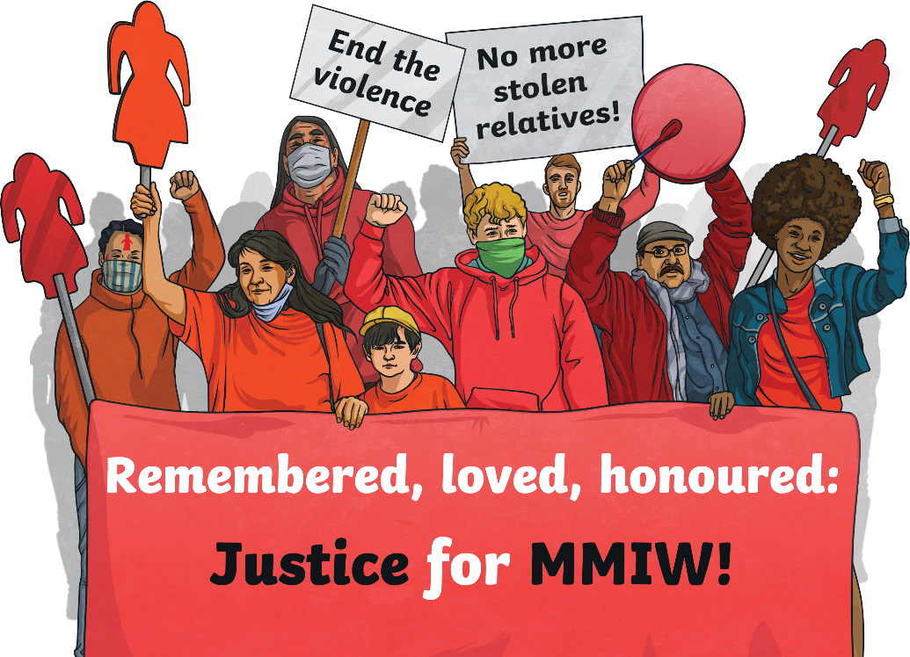
Why the Epidemic of MMIWG2S?
Indigenous people face greater threats of violence for multiple reasons:
Intergenerational trauma caused from the residential school system has created cycles of violence for Indigenous families. Every Indigenous person you know has a relative who attended residential school and is now having to live with that trauma.
Systemic racism is racism that lives within our social systems such as within schools or police forces. Systemic racism has allowed investigations to be treated differently with Indigenous murder cases, which often result in less attention to the case and less urgency when an Indigenous person is missing.

Slide 4
Why the Epidemic of MMIWG2S? (Continued)
Indigenous children make up over half the foster care system, a system that can often leave youth more vulnerable and susceptible to violence.
Indigenous communities are often in more isolated places where there is a surge of transient workers. We see higher rates of violence in places where the work is primarily male dominated and where the employees have no connection to the place or people. We also see high rates of violence in areas with vast forests and lack of cell service.

Slide 5
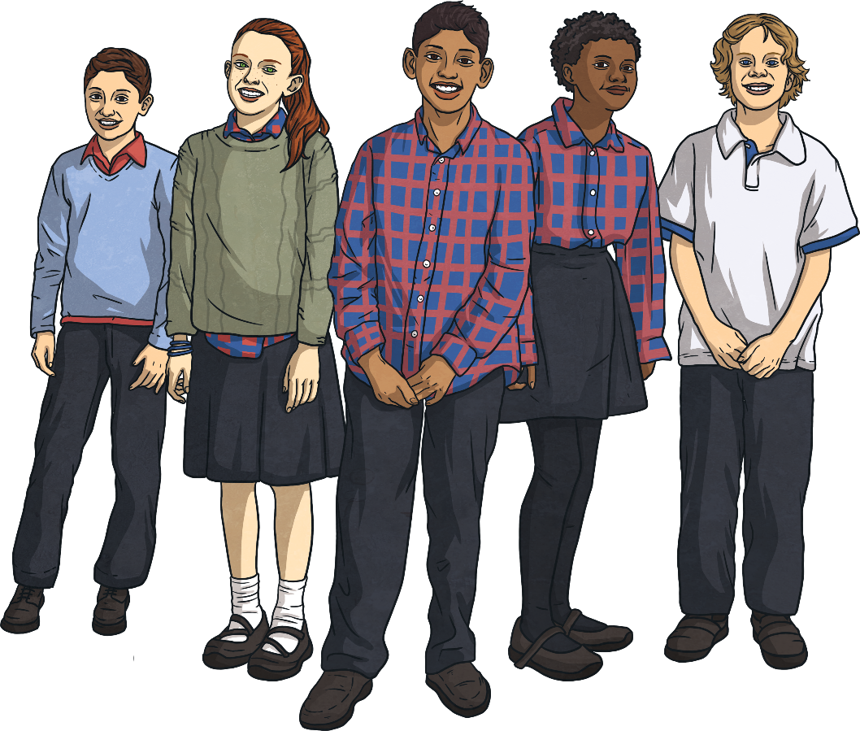
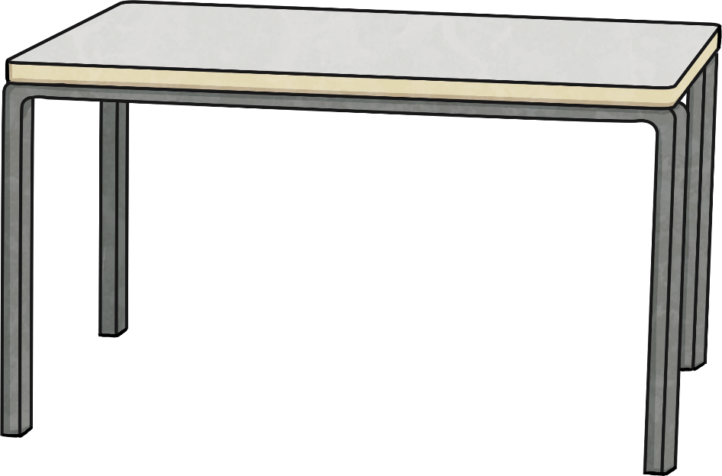
What Can You Do about It?
Many Canadians don’t know that this epidemic is happening. You can help to educate them about what you have learned.
Support Indigenous people and amplify their voices!
Hold fundraisers or awareness campaigns
Funds go towards MMIWG2

Slide 6
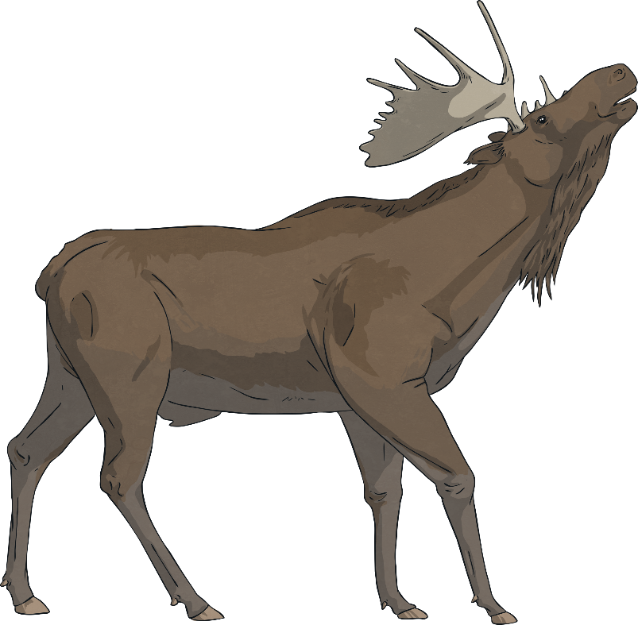
What Can You Do about It?
Learn their stories and remember that these people were sisters, cousins, aunts, mothers and grandmothers. You can become familiar with some of the stories by using the CBC database
Continue working to make Canada a safer place for people of all genders and cultural backgrounds. You can do this by ensuring you are a safe person and that you will stand up to violence when you see it.
Look into organizations such as The Moose Hide Campaign to see how you can make a change in your community
External Links/Apps Resource Disclaimer
We hope you find the information on our website and resources useful. This resource contains links to external websites and/or external apps. Please be aware that the inclusion of any link in this resource should not be taken as an endorsement of any kind by Twinkl of the linked website and/or app, or any association with its operators. You should also be aware that we have no control over the availability of the linked pages and/or apps. If the link is not working, please let us know by contacting TwinklCares and we will try to fix it although we can assume no responsibility if this is the case. We are not responsible for the content of external sites and/or external apps.

Slide 7
Activity
In groups of 2-3, answer the following questions and complete the activity.
How can you make your school or community safer? What are some action based projects your class could take?
Think about the important women in your life. List 3-5 things that would be different if you didn’t have them.
Design a piece of art dedicated to the missing and murdered Indigenous women, girls and Two-Spirit people. It can be of any medium available and should portray your emotions about this epidemic.

