Slide 1
“Monster”
By Dennis Saddleman
Survivor of the Kamloops Residential School

Slide 2
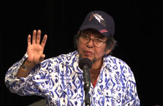
Dennis Saddleman

Slide 3
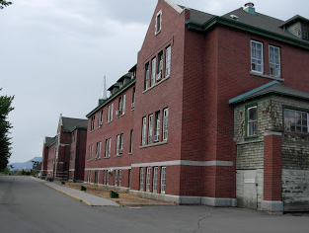
Kamloops Residential School
The Kamloops Indian Residential School was part of the Canadian residential school system and one of the 130 schools for First Nations children that operated in Canada between 1874 and 1996.

Slide 4
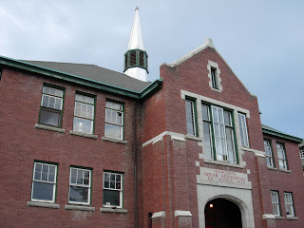
Kamloops Residential School
The Kamloops School was opened in 1893 (initially as the Kamloops Industrial School) and continued operation until 1977.

Slide 5
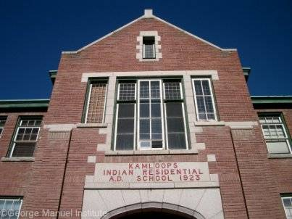
Kamloops Residential School
“Monster” by Dennis Saddleman
Truth and Reconciliation Hearings
May 2013

Slide 6
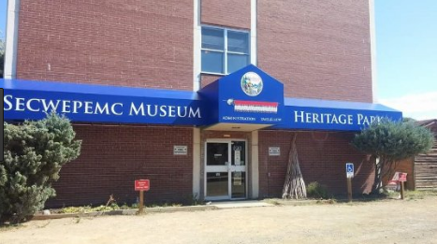
Kamloops Residential School Today

