Slide 1
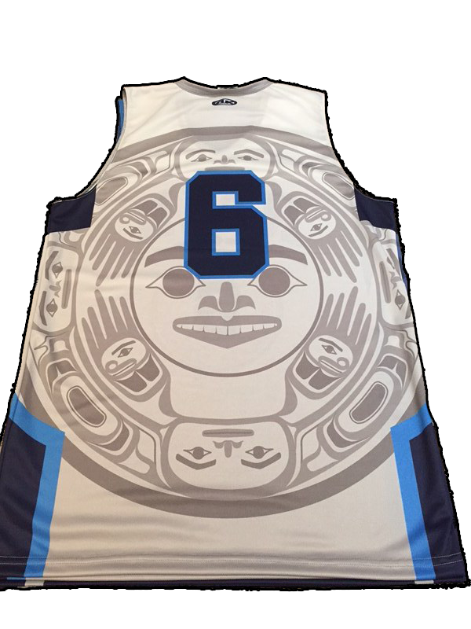
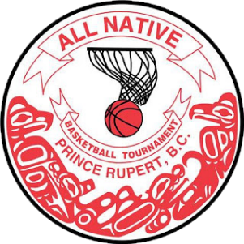
ANBT All Native Basketball Tournament

Slide 2
ANBT
The All Native Basketball Tournament has played a significant cultural and economic role on the North Coast. First Nations from various communities come together to celebrate their pride and identity as they represent their communities and nations.

Slide 3
ANBT
The ANBT is an essential part of North Coast life during the winter. It’s huge significance offers Prince Rupert an economic boost prior to and throughout it’s duration.

Slide 4
anbt
Each year a new dance group representing one of the participating communities is chosen to welcome the Elders, players and fans to the opening ceremonies.

Slide 5
ANBT History
Since the early years of this century, basketball has been played in First Nations communities along the coast. It requires little equipment and can be played indoors, a definite plus on this rainy coast.

Slide 6
ANBT History
When the people worked at the salmon canneries on the Skeena River during the summer, the main recreation was playing basketball. It might be in a net loft or on the dock, but somewhere around the cannery you’d find a hoop.

Slide 7
ANBT History
On to the first ANBT
In 1947 the Prince Rupert Basketball Association decided to host the Northern British Columbia Coast Indian Championship tournament.
Seven teams played that year and four hundred people turned out to watch the three-day event. The tournament was so successful that the organizers decided to make it an annual event.

Slide 8
ANBT history
The Old Civic Centre
On to the first ANBT
For the next three years the games were played in the old Civic Centre. In 1950 the Native Basketball Association took over the organization of the tournament.

Slide 9
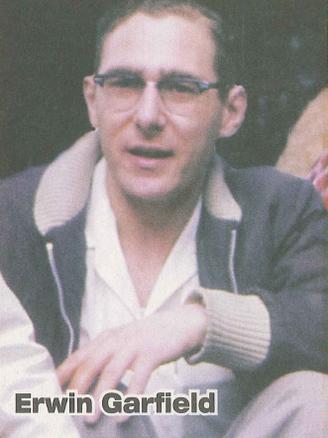
ANBT History
In the fall of 1959, some of the organizers of the Prince Rupert Basketball Association were worried about the lack of interest in basketball. Fans weren’t supporting it the way they used to. But a local businessman, Irwin Garfield, was the first to suggest bringing back the old tournament. Others agreed, and the Prince Rupert and District All Native Basketball Tournament was created.

Slide 10
ANBT History
The First ANBT
The Senior's final was as exciting as any since, with Kitkatla defeating Kitamaat 61 to 57. The tournament was a huge success, even making a bit of money, and the trend was set.

Slide 11
ANBT History
PRSS
The old Civic Centre couldn’t hold all the people who wanted to watch the final games, so in 1963, the championship games were held in the gym of the new Prince Rupert Senior Secondary School. One thousand fans packed into the bleachers.

Slide 12
ANBT History
The Jim Ciccone Civic Centre
In 1972 the new Civic Centre was completed and the tournament moved to the new facility and the number of teams increased.

Slide 13
ANBT 90’s
In 1992 Roberta Edzerza was the first woman to play in the All Native tournament joining the Trojans, a men’s senior team.
This was the catalyst that started a whole new era for the All Native Basketball Tournament.

Slide 14
ANBT 90’s
Women’s Division
In 1993 the ANBT added a Women’s division to its program.
Since 1993 the Women’s division has become a permanent feature adding popularity and fandom to the ANBT.

Slide 15
ANBT 90’s
Also in 1993, the Masters’ Division for men over 35 was added. Now there are at least 50 teams competing in the tournament. To accommodate the expansion, a second gym is used. At first Charles Hays Secondary School gym was used, but more recently the Civic Centre Arena has been temporarily transformed into a basketball court with a portable floor.

Slide 16
ANBT
The Intermediate Division
The ANBT’s Intermediate division has added even more excitement to the tournament by allowing young up-and-coming stars to get their first chance to shine on the big stage.

Slide 17
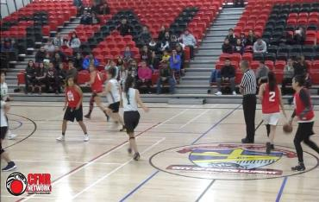
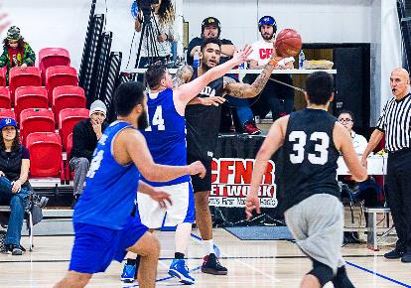
ANBT
Since 1992, a Qualifying Tournament has been held in November. The top nine teams in the tournament automatically qualify for the next year’s games, but the first three teams that are eliminated, along with other interested teams, have to play off in November for two open berths in the February tournament. The tournament continues to grow and change to meet the needs of its players, fans and communities.

Slide 18
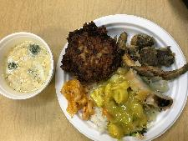
ANBT
In addition, First Nations people have an opportunity to sell their arts, crafts, and traditional food throughout the week in the auditorium, which is always packed with people buying things, sharing a meal or socializing with friends.

Slide 19
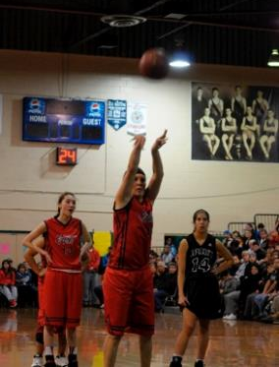
ANBT Hall of Fame
Since 2003 the ANBT has inducted some of the most prominent and influential participants to the ANBT Hall of Fame recognizing their individual and team accomplishments.

Slide 20
ANBT
The All Native Tournament is the largest basketball tournament in Canada. It is a unique cultural and sporting event that has drawn considerable attention over the years from the media.

Slide 21
ANBT
Prince Rupert

